Slide 1


User Guide

Slide 2
Summary
I Login
II Project Design
III Cost-Benefits
A - Project Scoping
B - Cost Benefits
C - Dashboards
D - Comparison
IV Financing
A - Funding
B - Business Model
V Settings

Slide 3
I Login
Back to summary

Slide 4
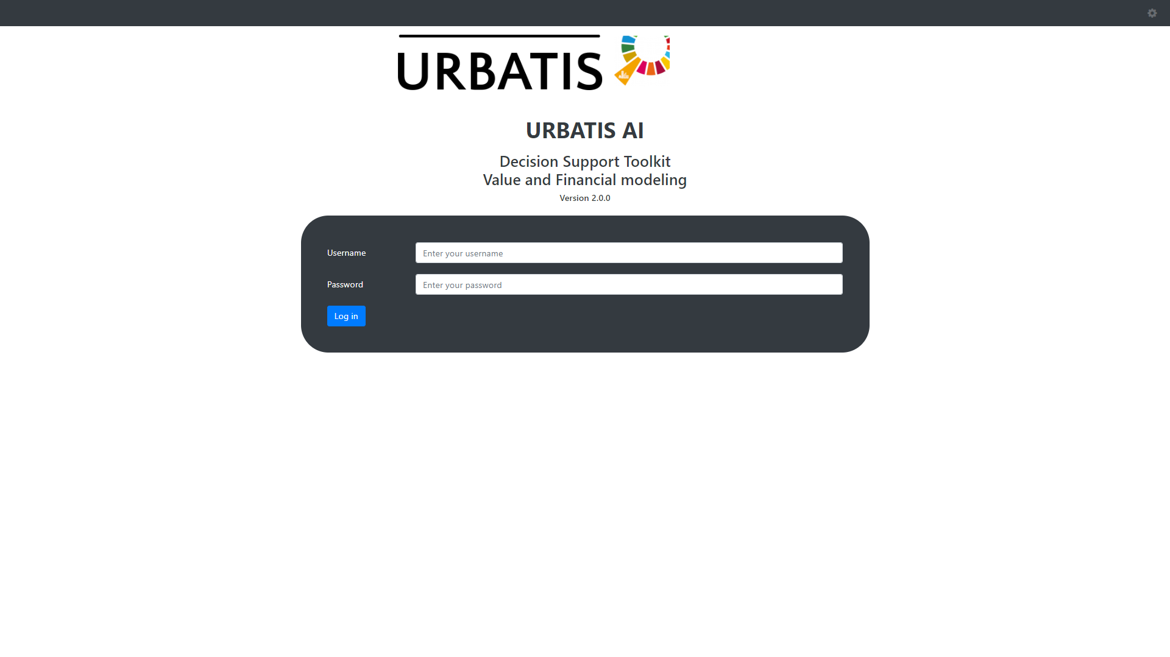
Log in with your username and password

Slide 5
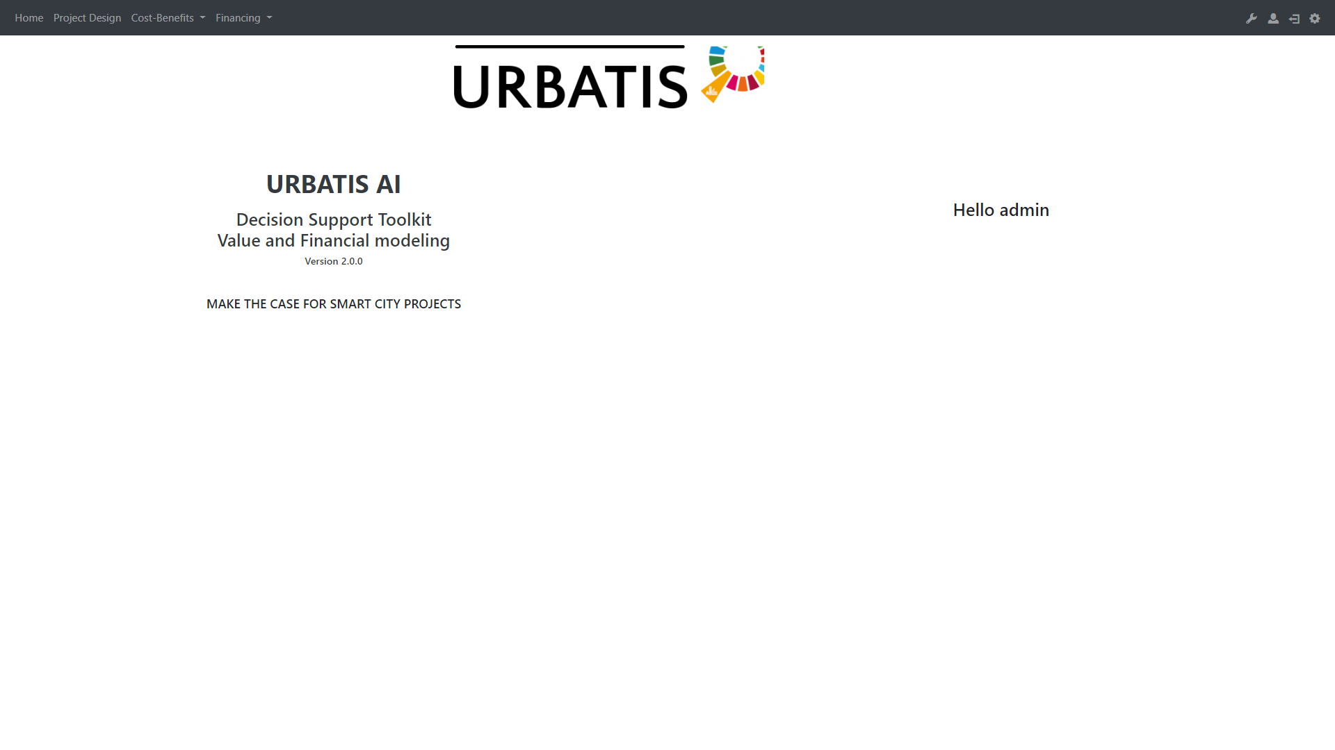
Here you have access to the settings.
This is the NavBar. It allows you to navigate through the differents parts.

Slide 6
II Project Design
Back to summary

Slide 7
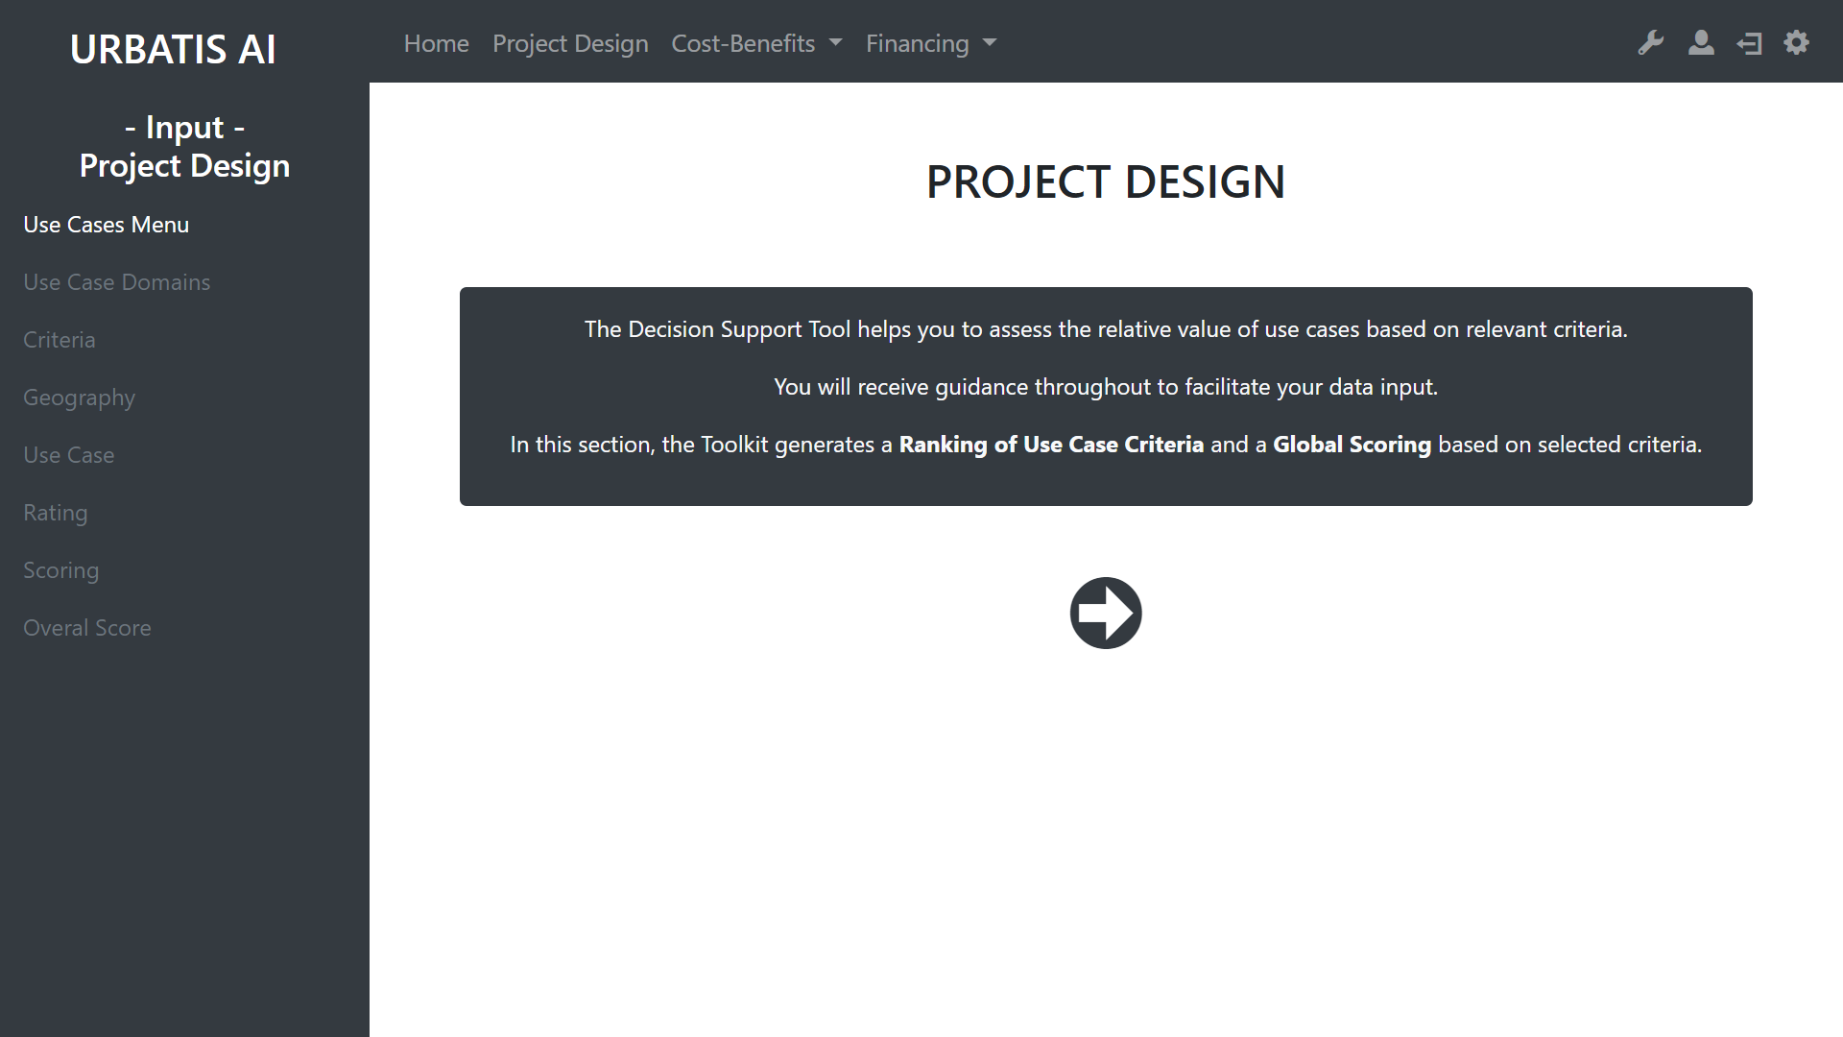
You can use this arrow to start the design.
With this sidebar you can navigate through the differents section of the project design.
However, you can only access to white links. The grey links need more information to be activated.

Slide 8
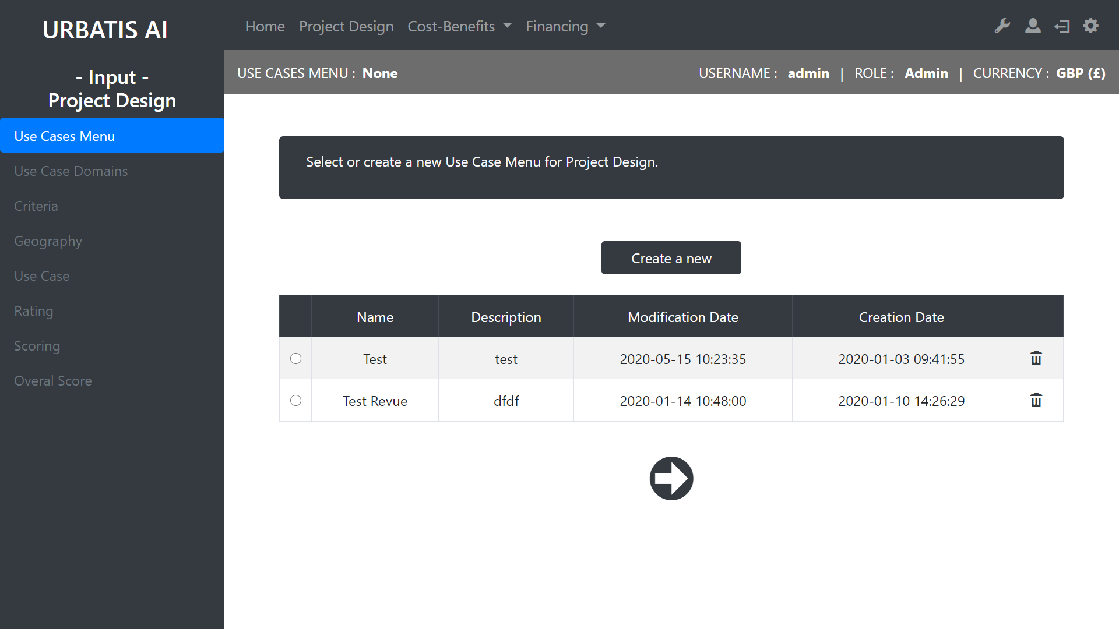
To design your Use Case Menu , you need to select one existing or to create a new one.
Creat a new Use Case Menu
Review of existing Use Case Menu
Drop the Use Case Menu
Go to the next step

Slide 9
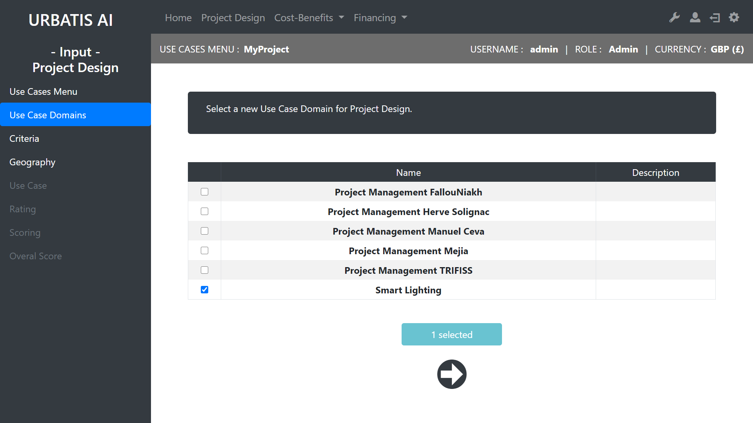
Once the project is selected, there more active links (in white)
Selection of domains for the Use Case Menu
Go to the next step

Slide 10
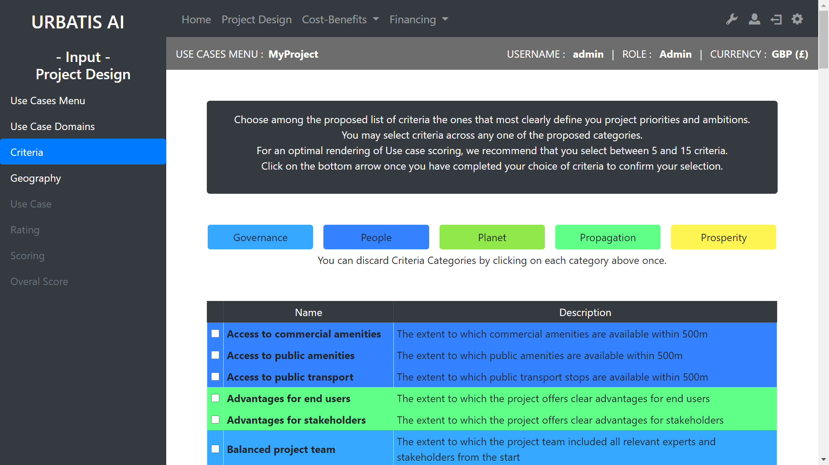
You can discard some criteria categories by clicking on each categoriy.

Slide 11
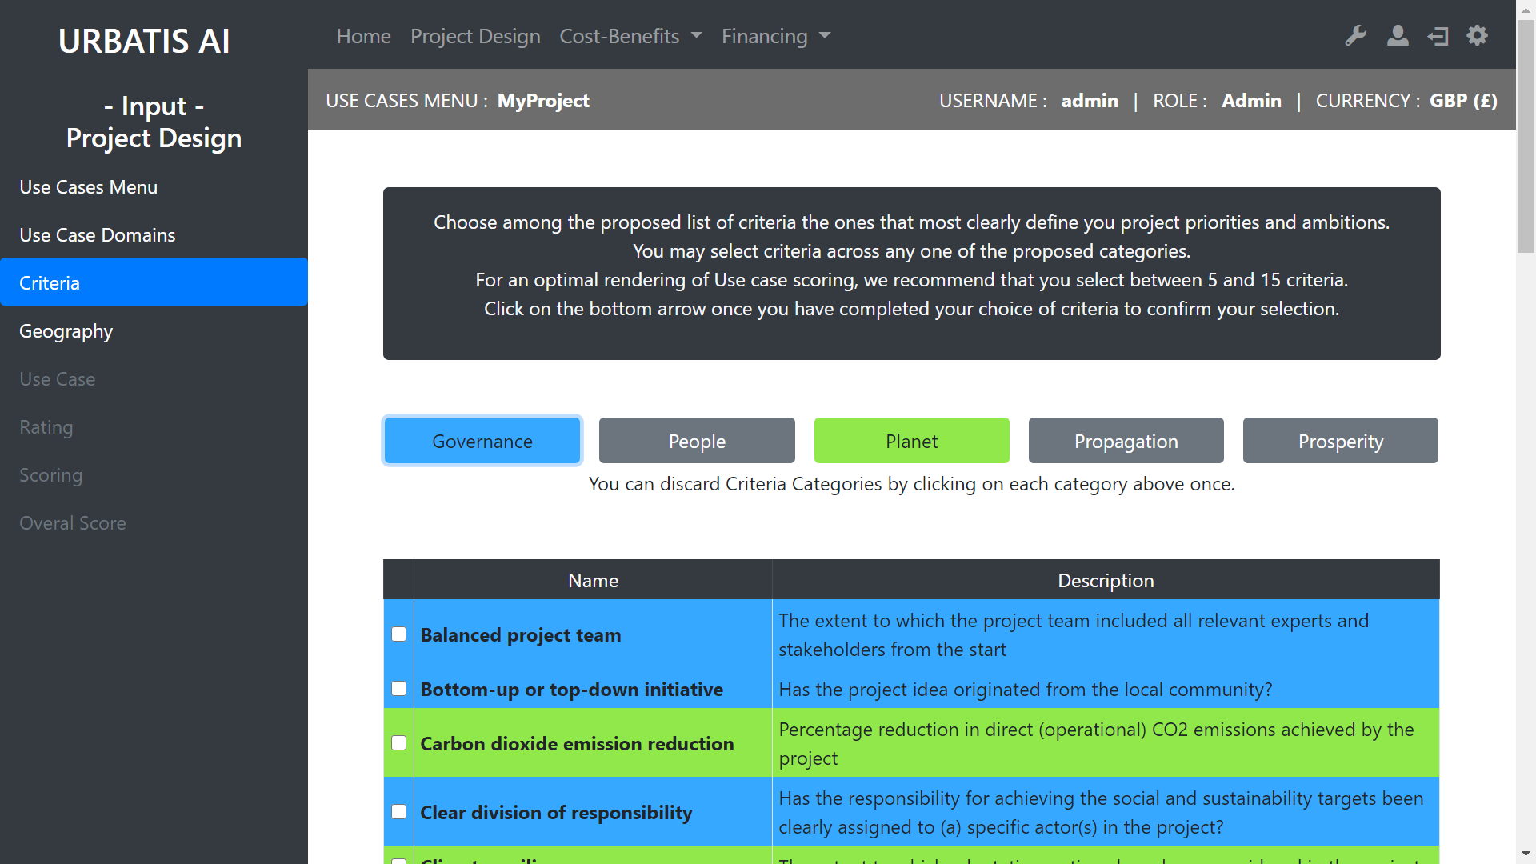
The discarted categories are now missing from the list

Slide 12
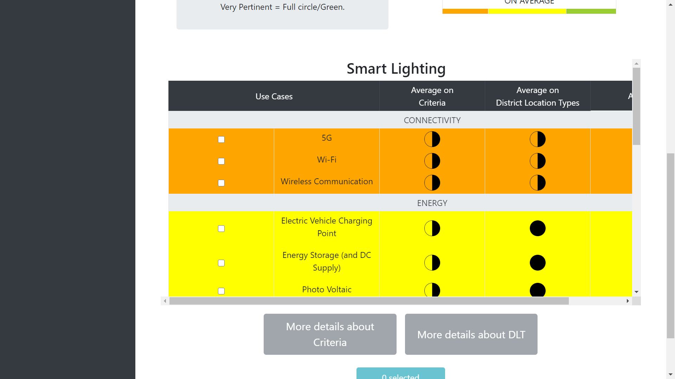
Summary of different solutions
If you want more details
Use case

Slide 13
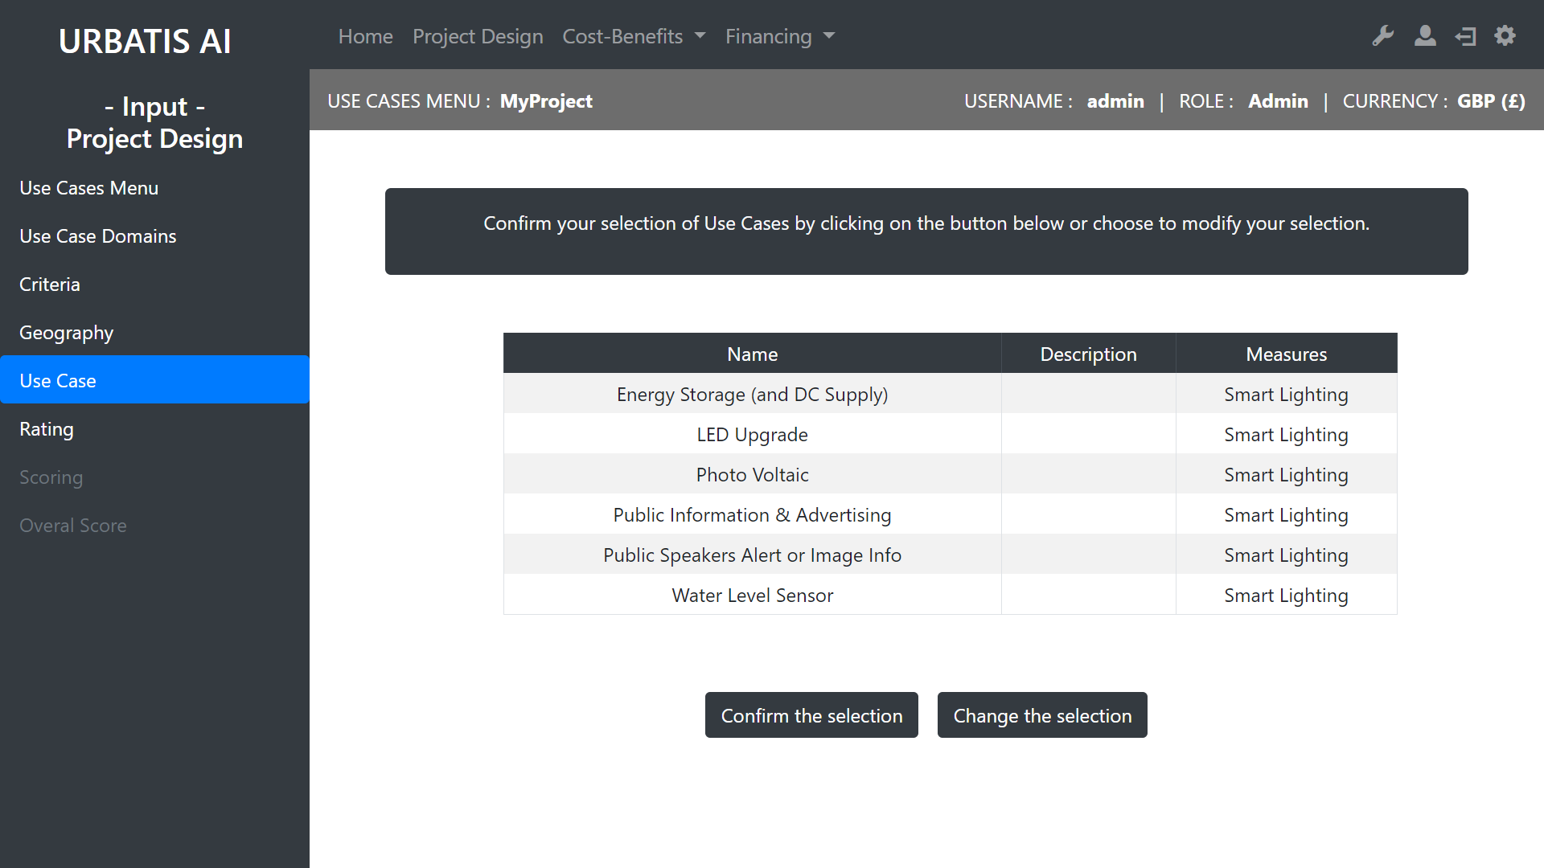
Review of the solutions selected
You can change or confirm your selection

Slide 14
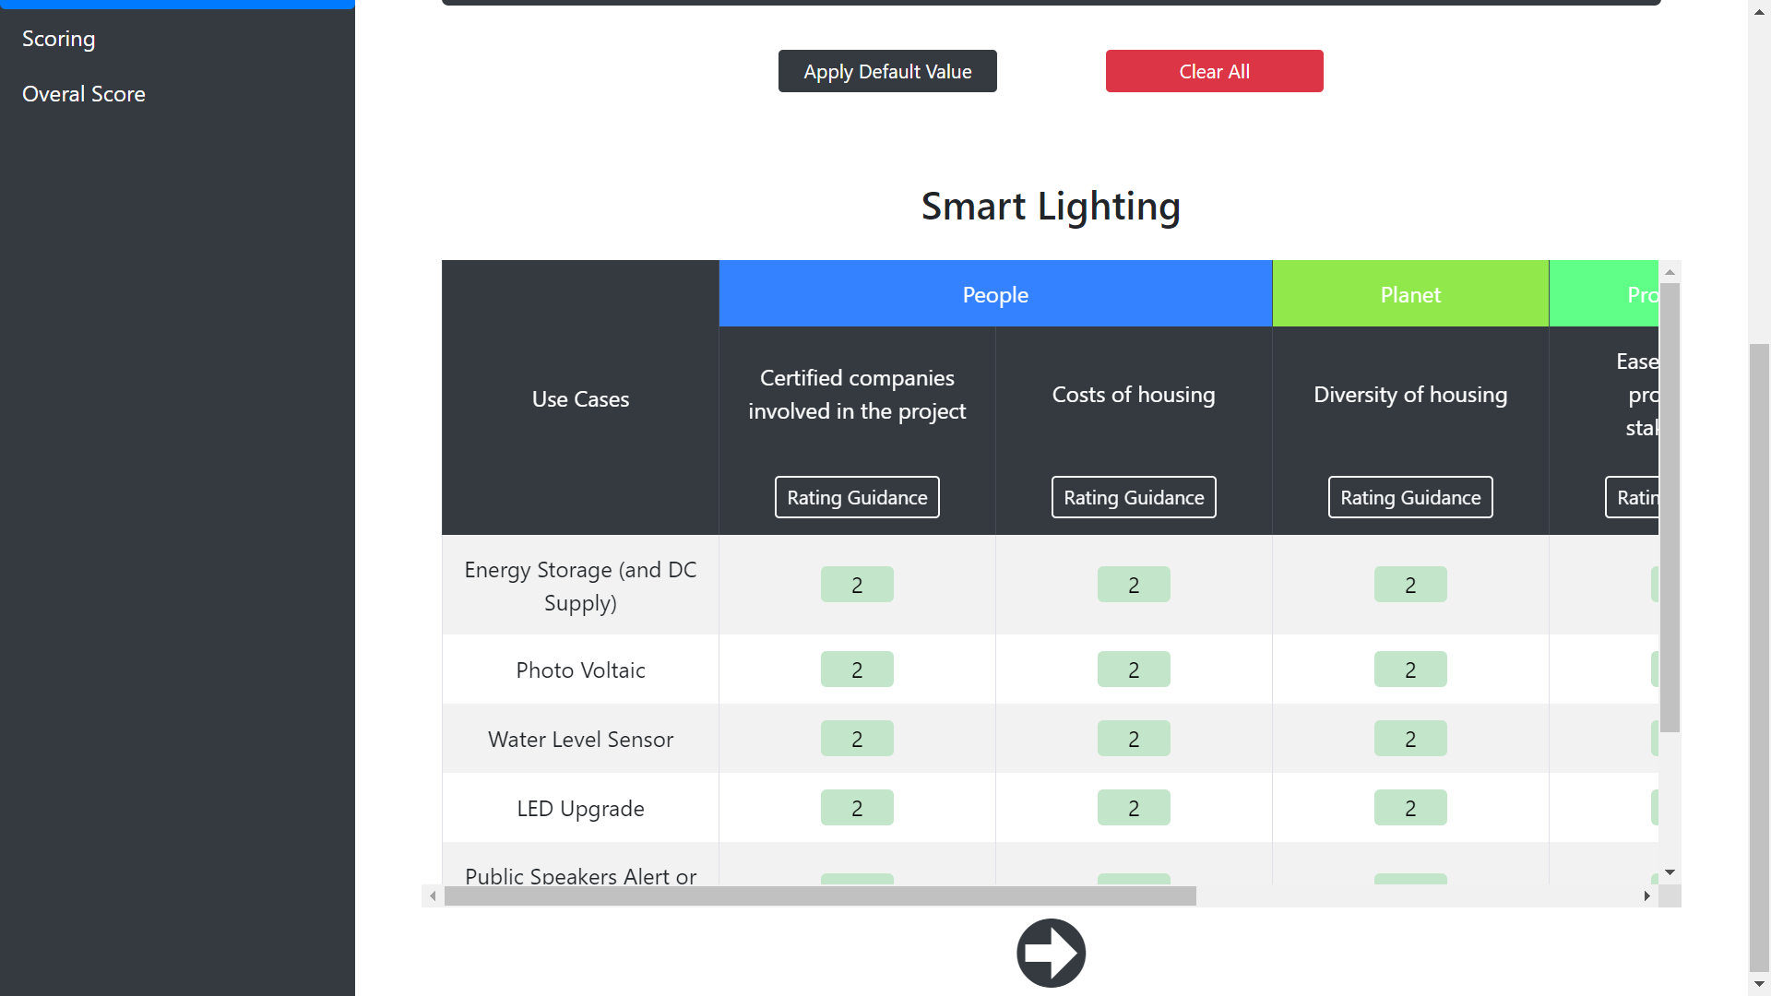
You can apply
default values from our database
You can edit the rating values
This will help you to understand how to edit the rates
Ease of use for professional stakeholders
Rating

Slide 15
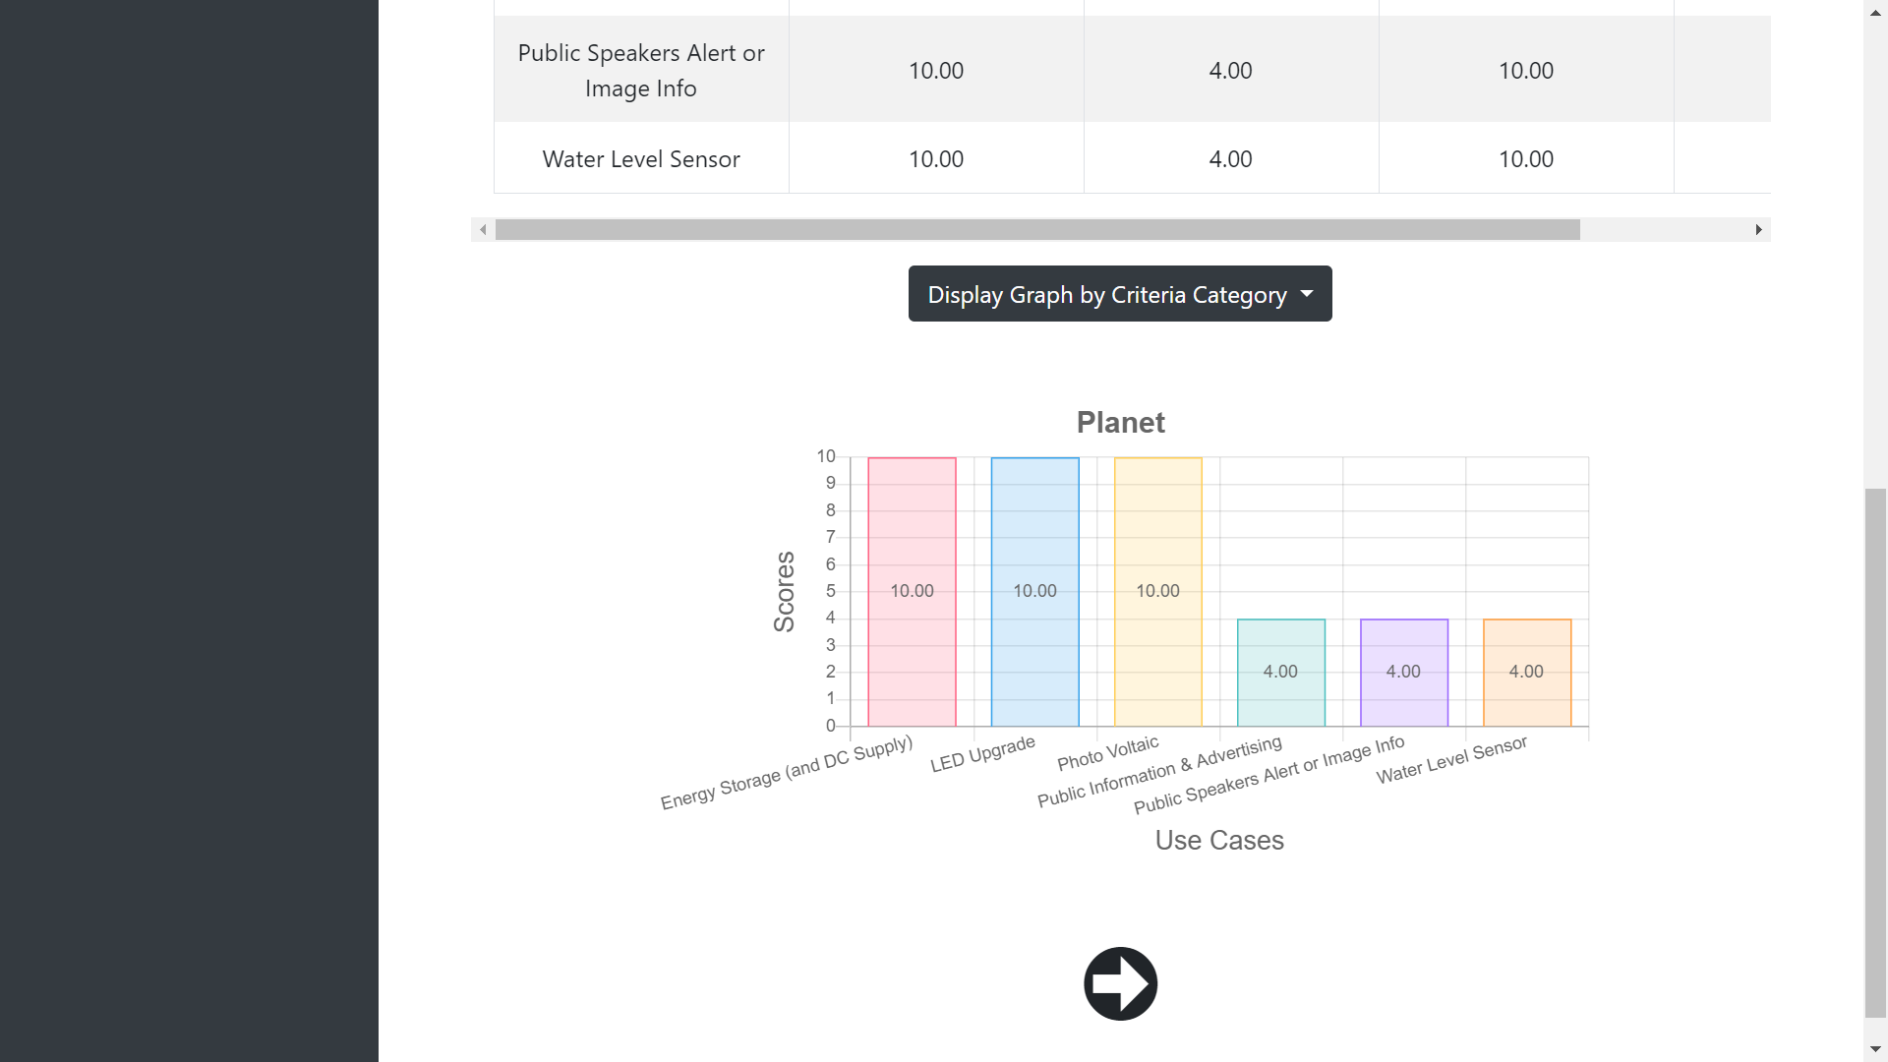
Select a graph to display
Scoring

Slide 16
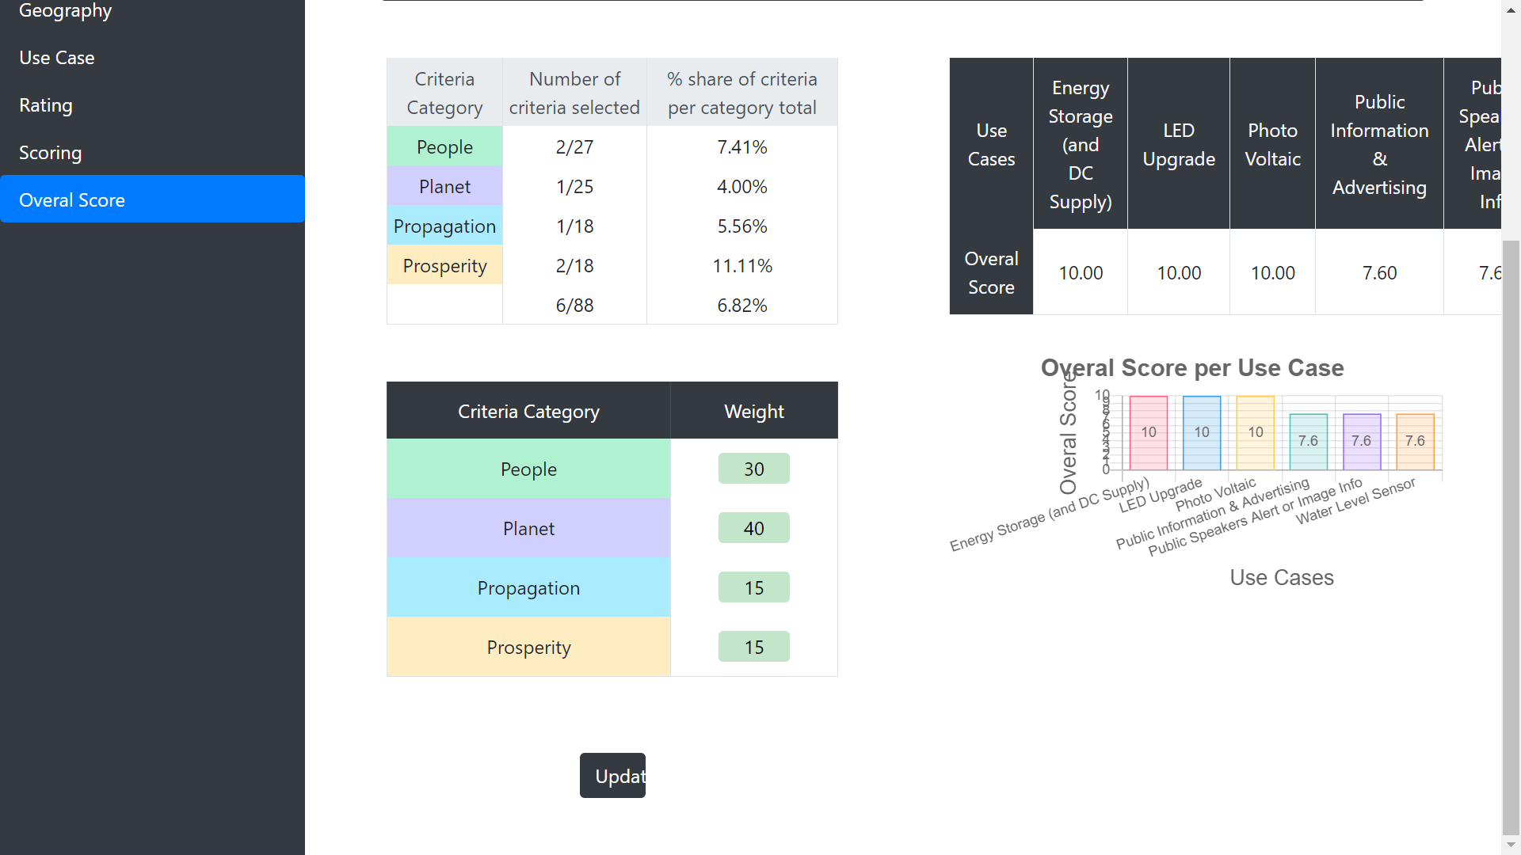
You can adjust the weigth of each criteria category

Slide 17
III Cost-Benefits
Back to summary

Slide 18
A - Project Scoping
Back to summary

Slide 19
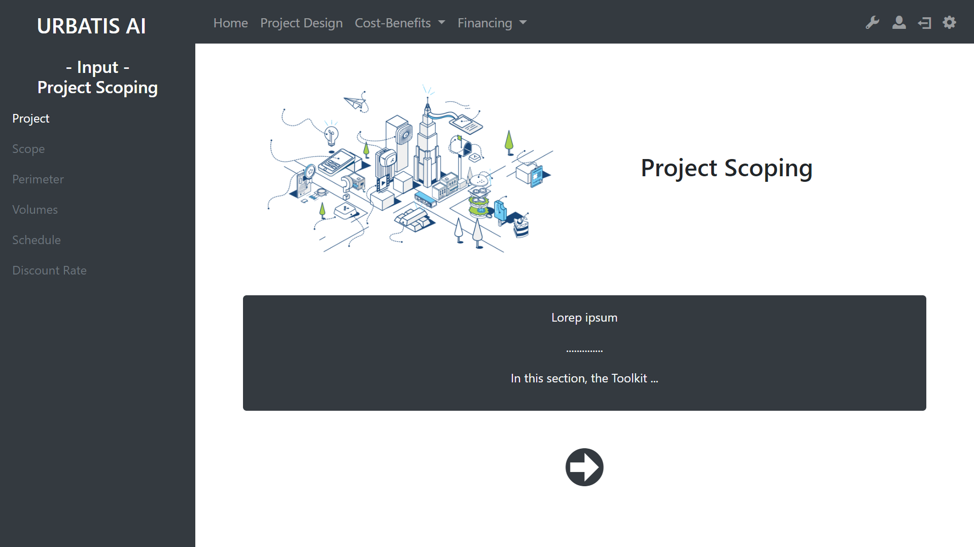
With this sidebar you can navigate through the differents section of the project scoping.
However, you can only access to white links. The grey links need more information to be activated.
You can use this arrow to start the project scoping.

Slide 20
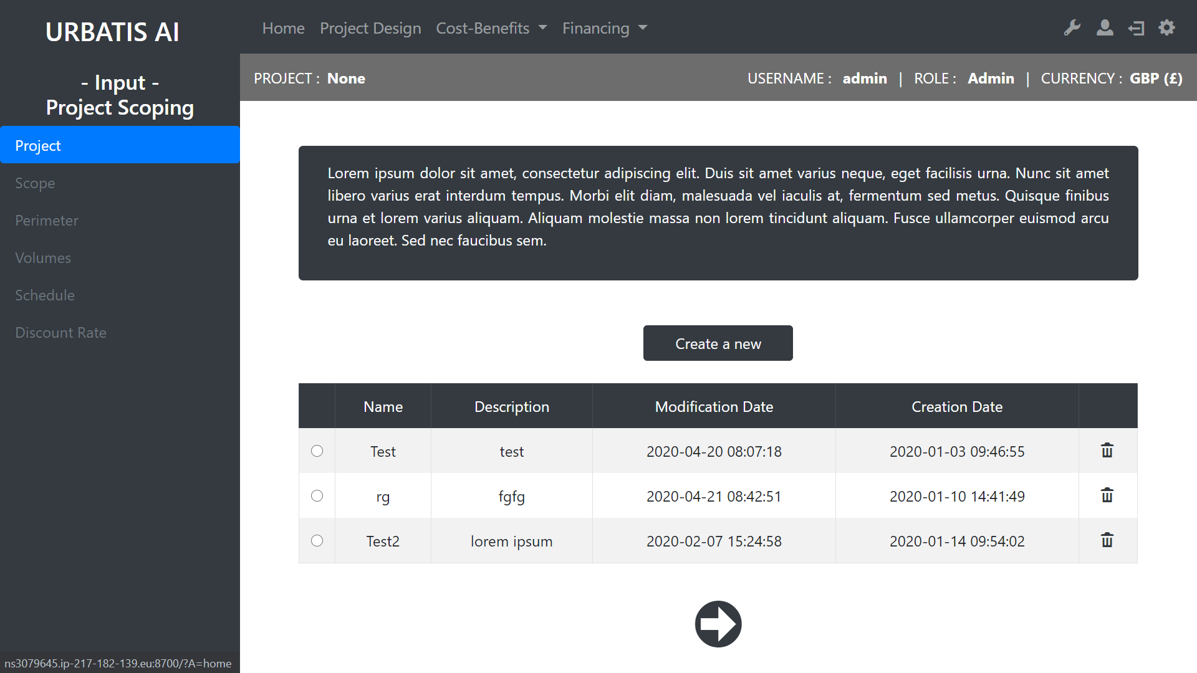
You need to select one existing or to create a new one.
Creat a new project
Review of existing scopes
Drop the scope
Go to the next step

Slide 21
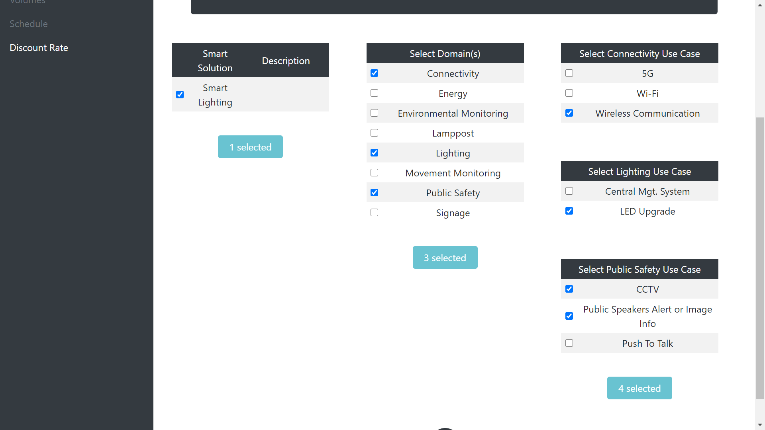
Select the scope
Scope

Slide 22
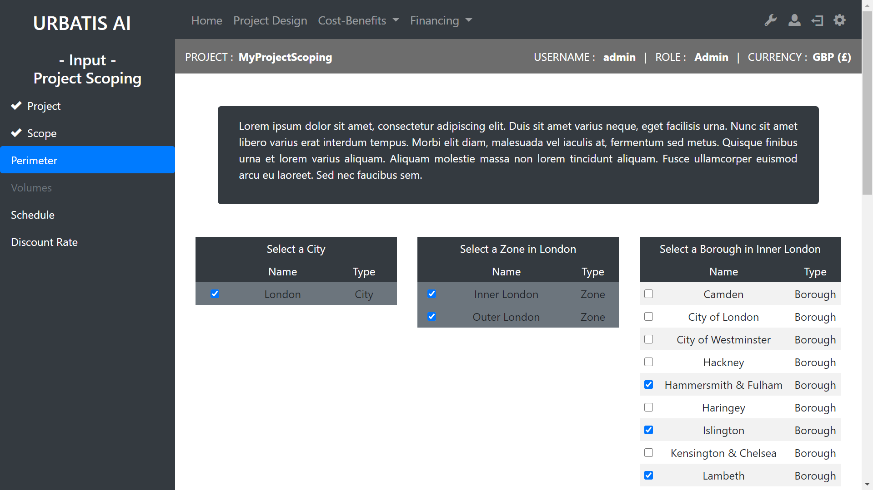
Select the Perimeter

Slide 23
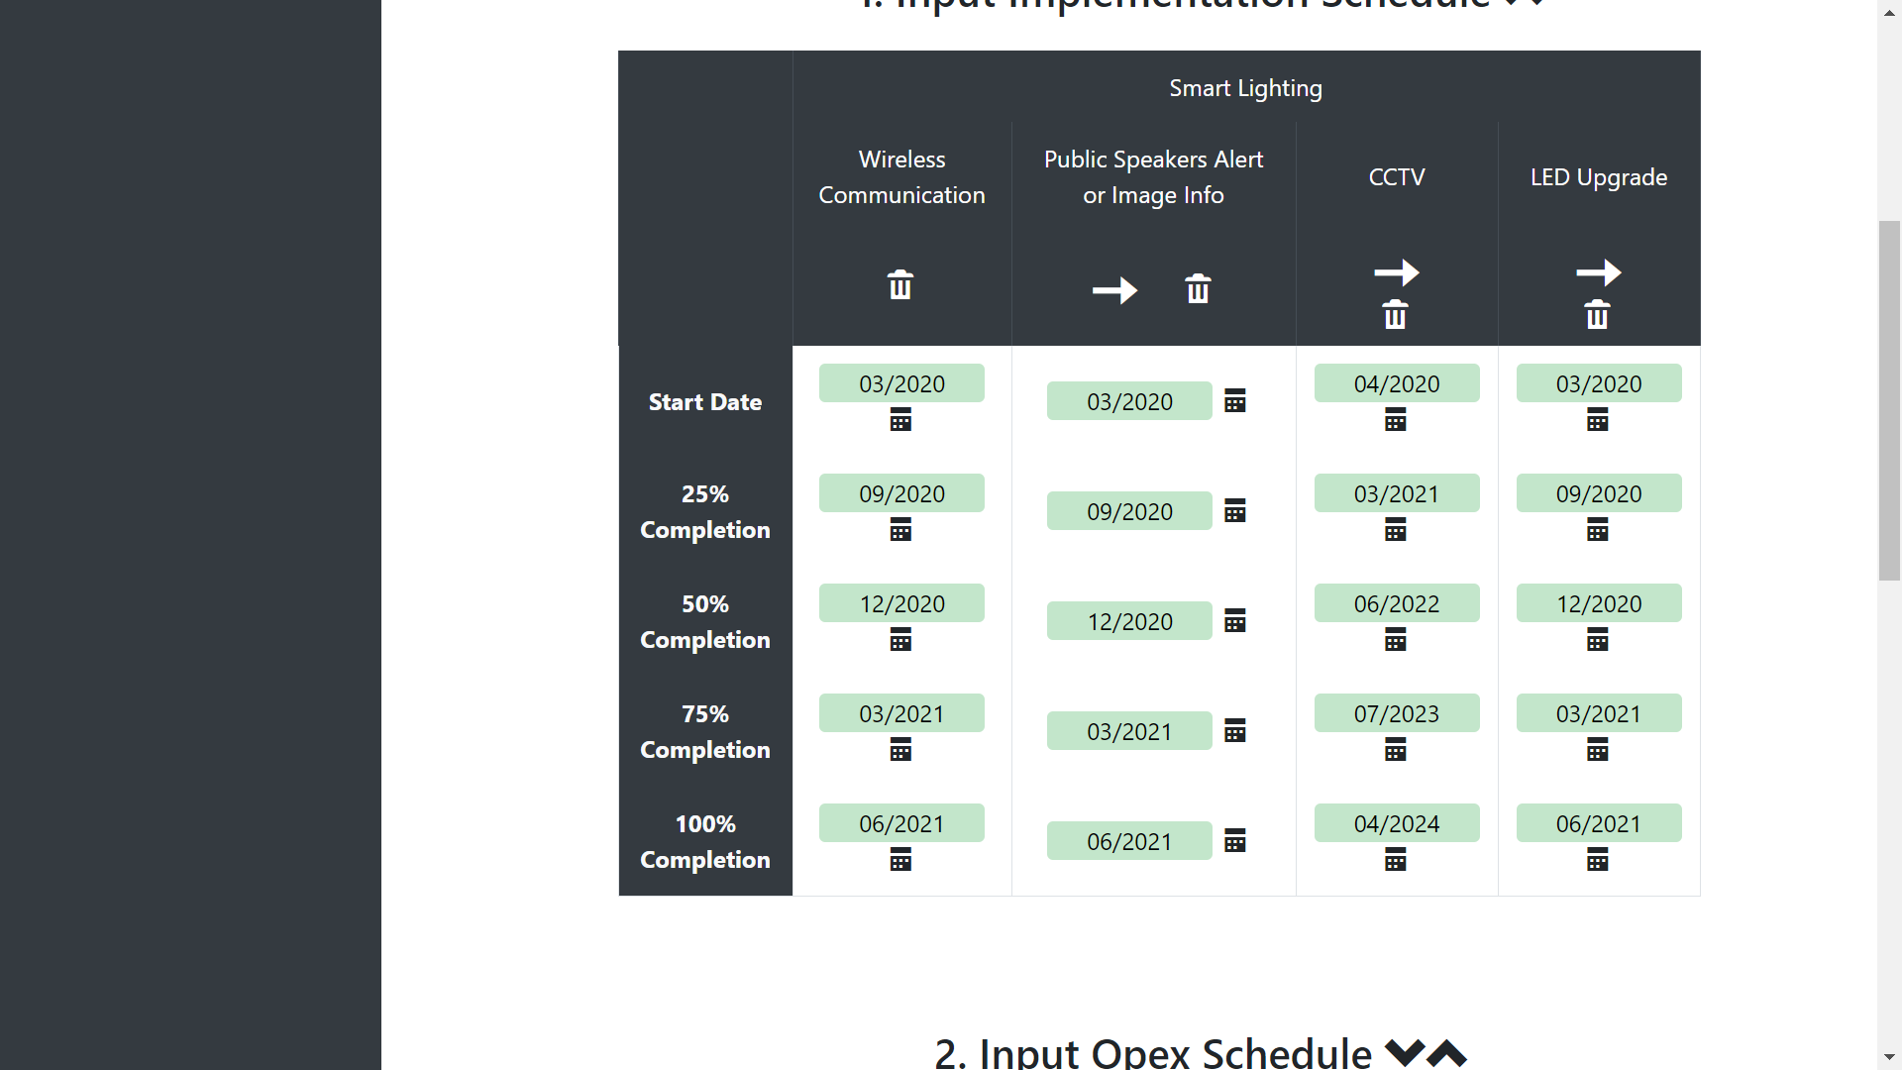
Clear the colomn
You need to edit the schedule for 3 types of input :
Implementation
Opex
Revenues Ramp-up
Be carefull, you have to select logical dates (the start date can’t be after the end date)
Copy the left colomn
Schedule

Slide 24
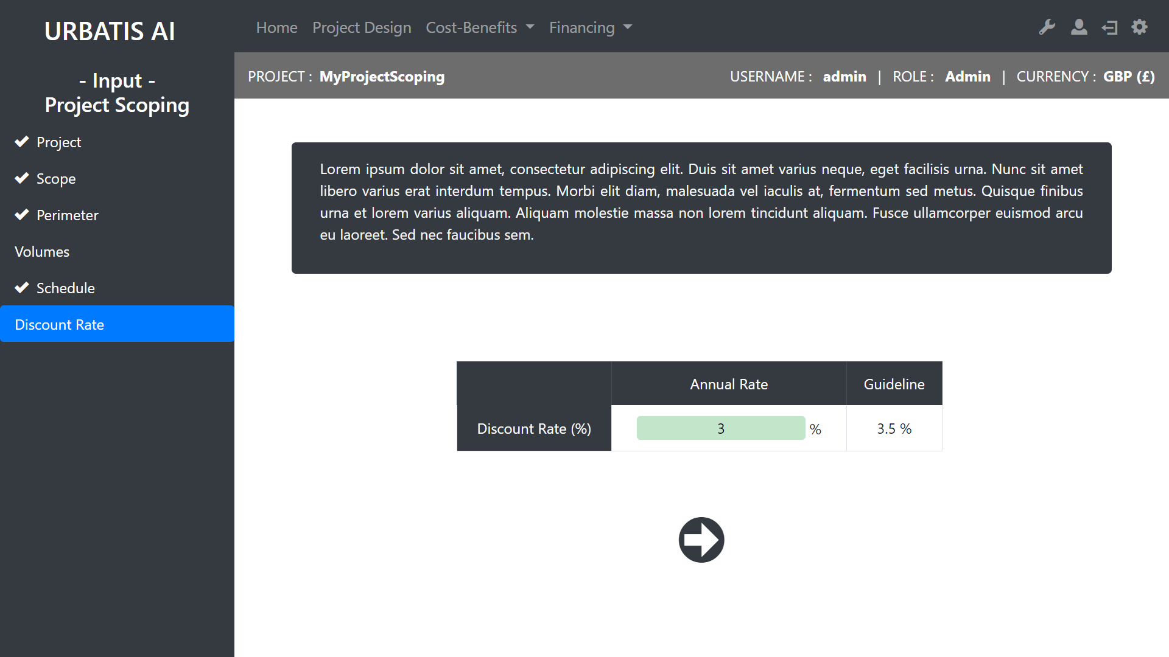
You can edit the discount rate. This rate is very important and should be chosen carfully
You have an approximation of a good discount rate

Slide 25
B - Cost Benefits
Back to summary

Slide 26
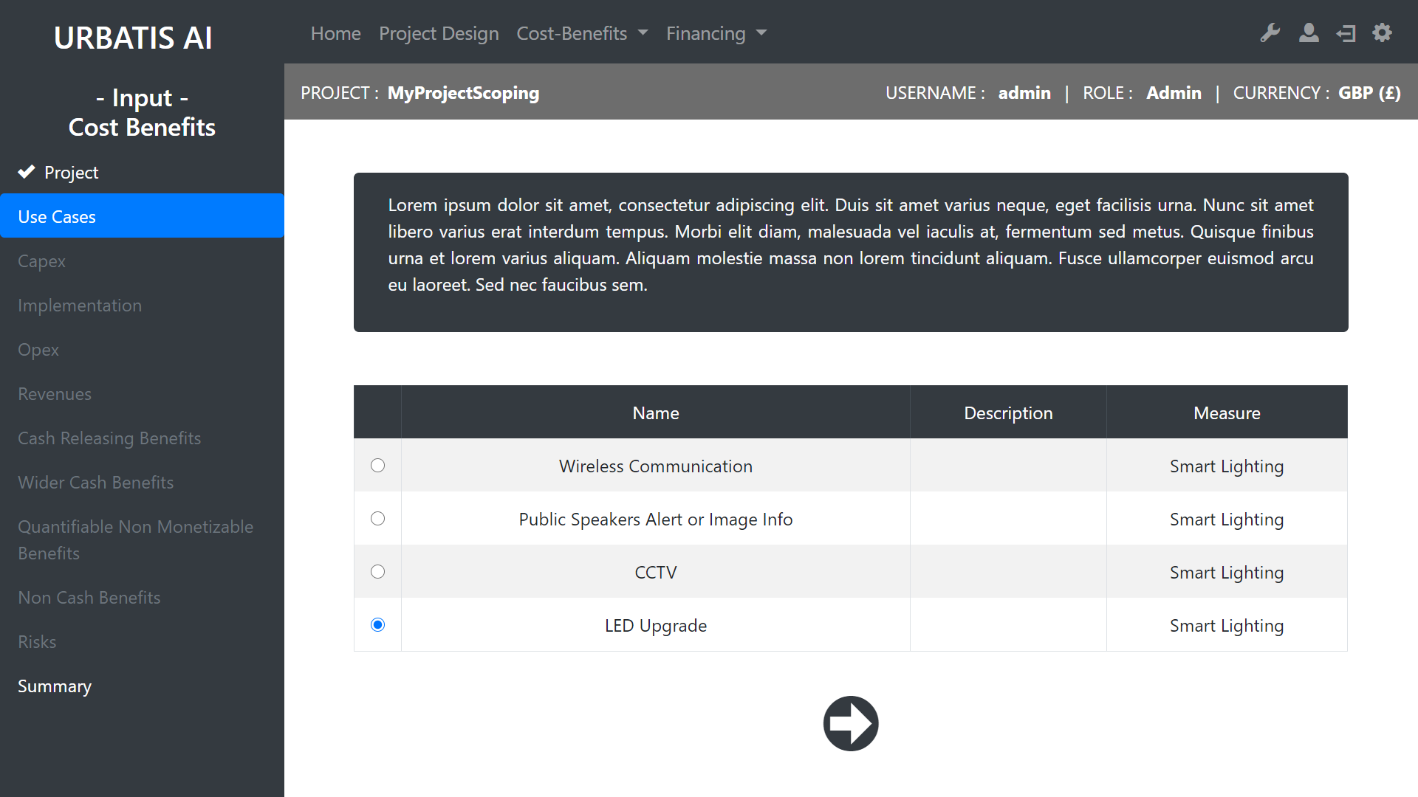
Select a Use Case to edit

Slide 27
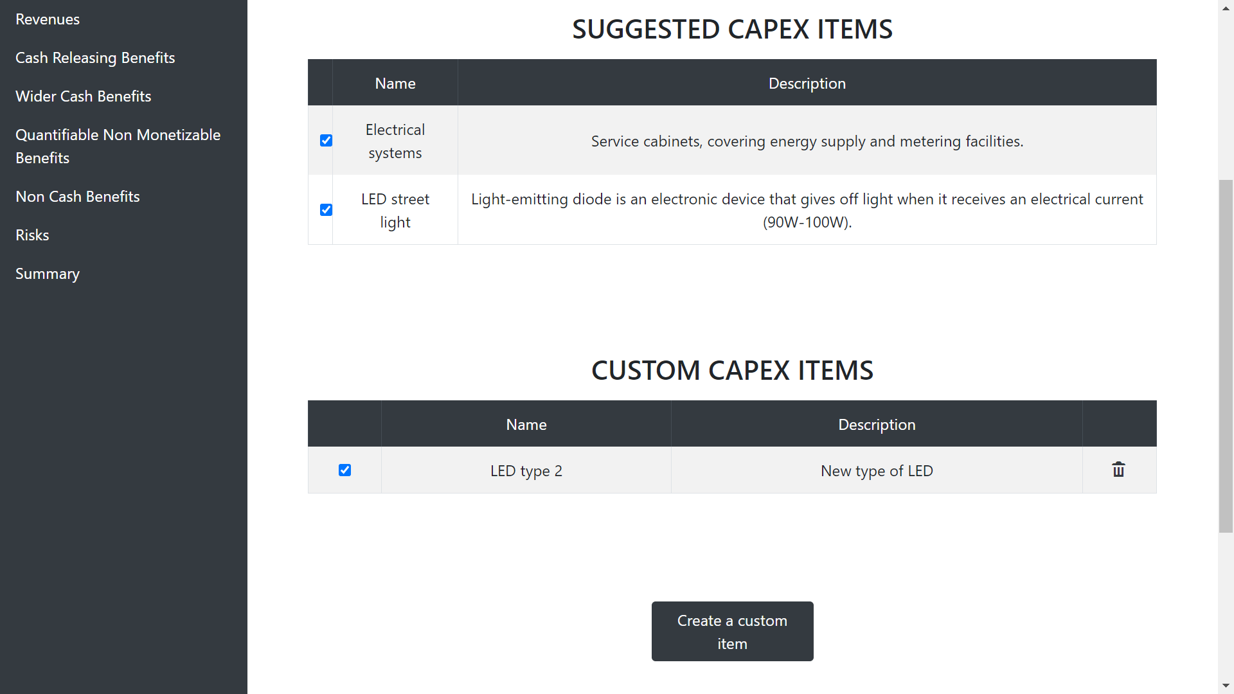
You can select suggested capex items from the database
You can select your own capex items
You can create your own capex items
Capex

Slide 28
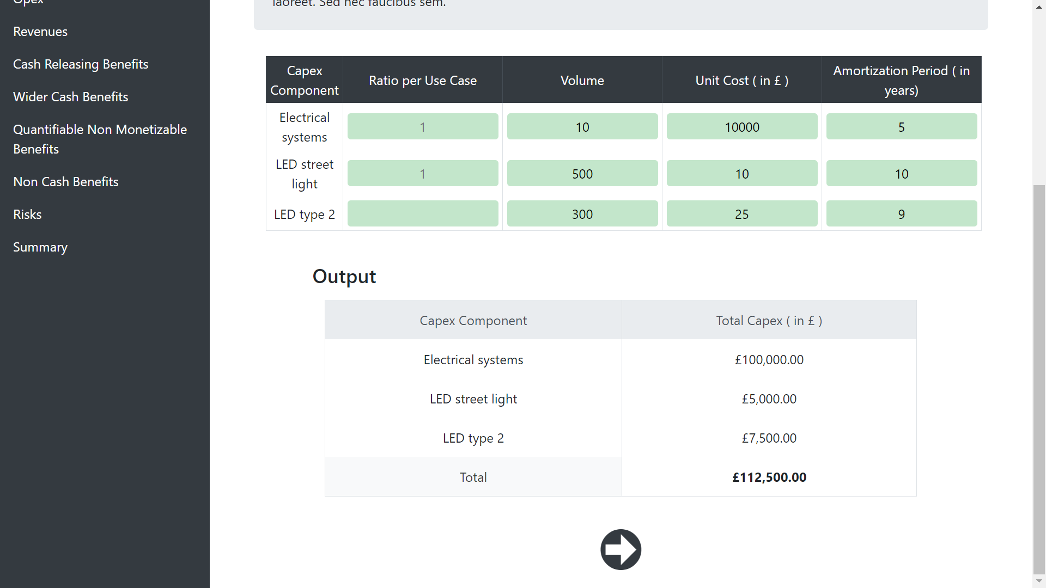
Edit this table …
… and get the capex summary
Capex

Slide 29
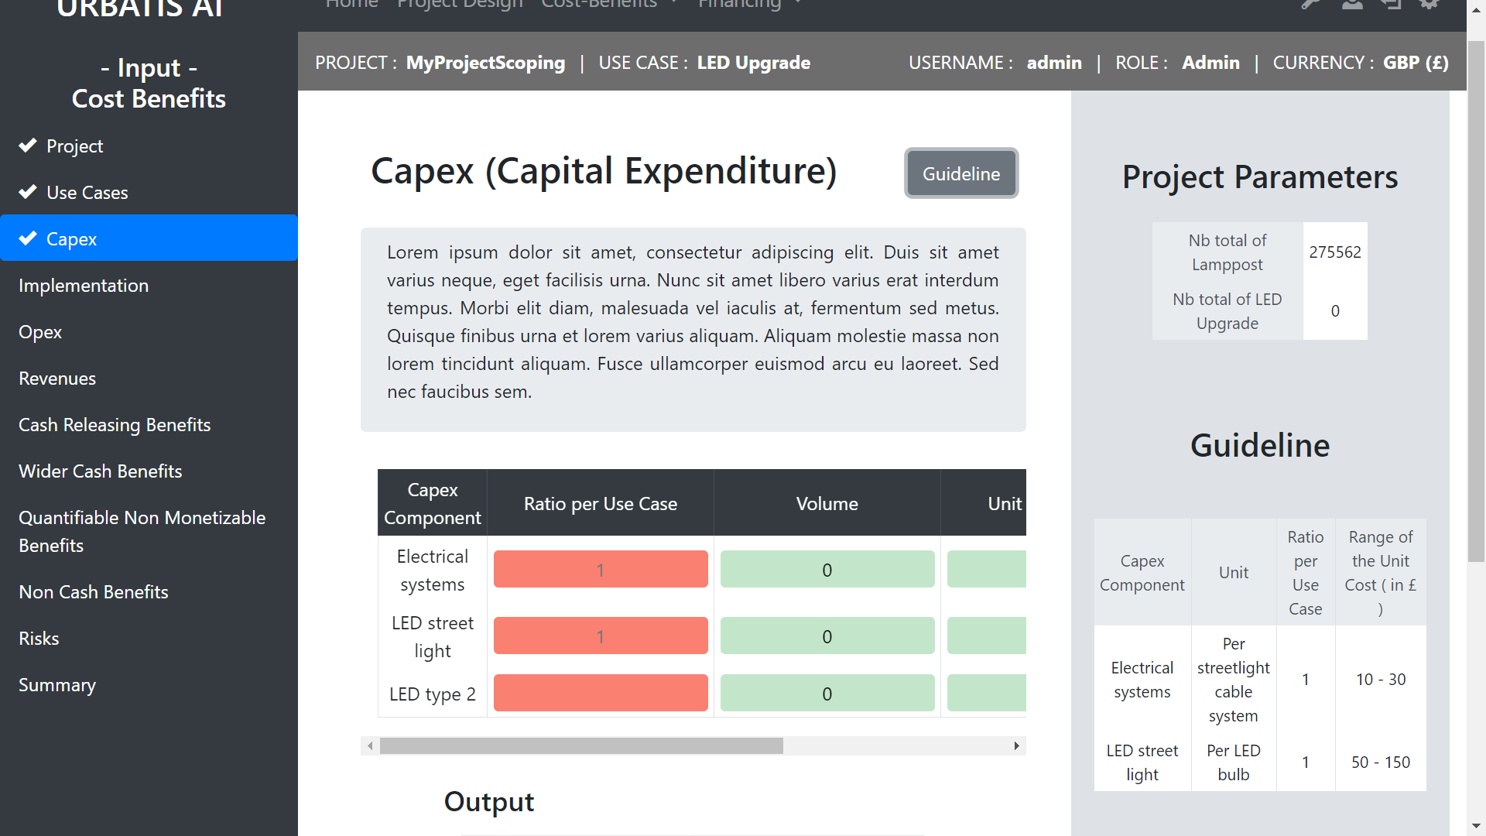
The guide line will help you to set the values of the table

Slide 30
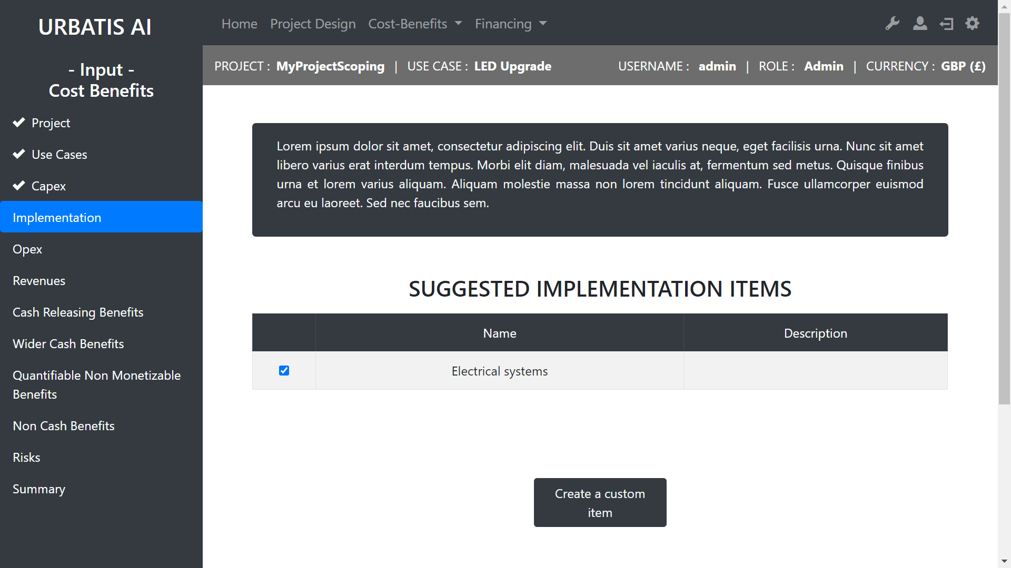
Select implementation items from our data base
Create your own implementation item

Slide 31
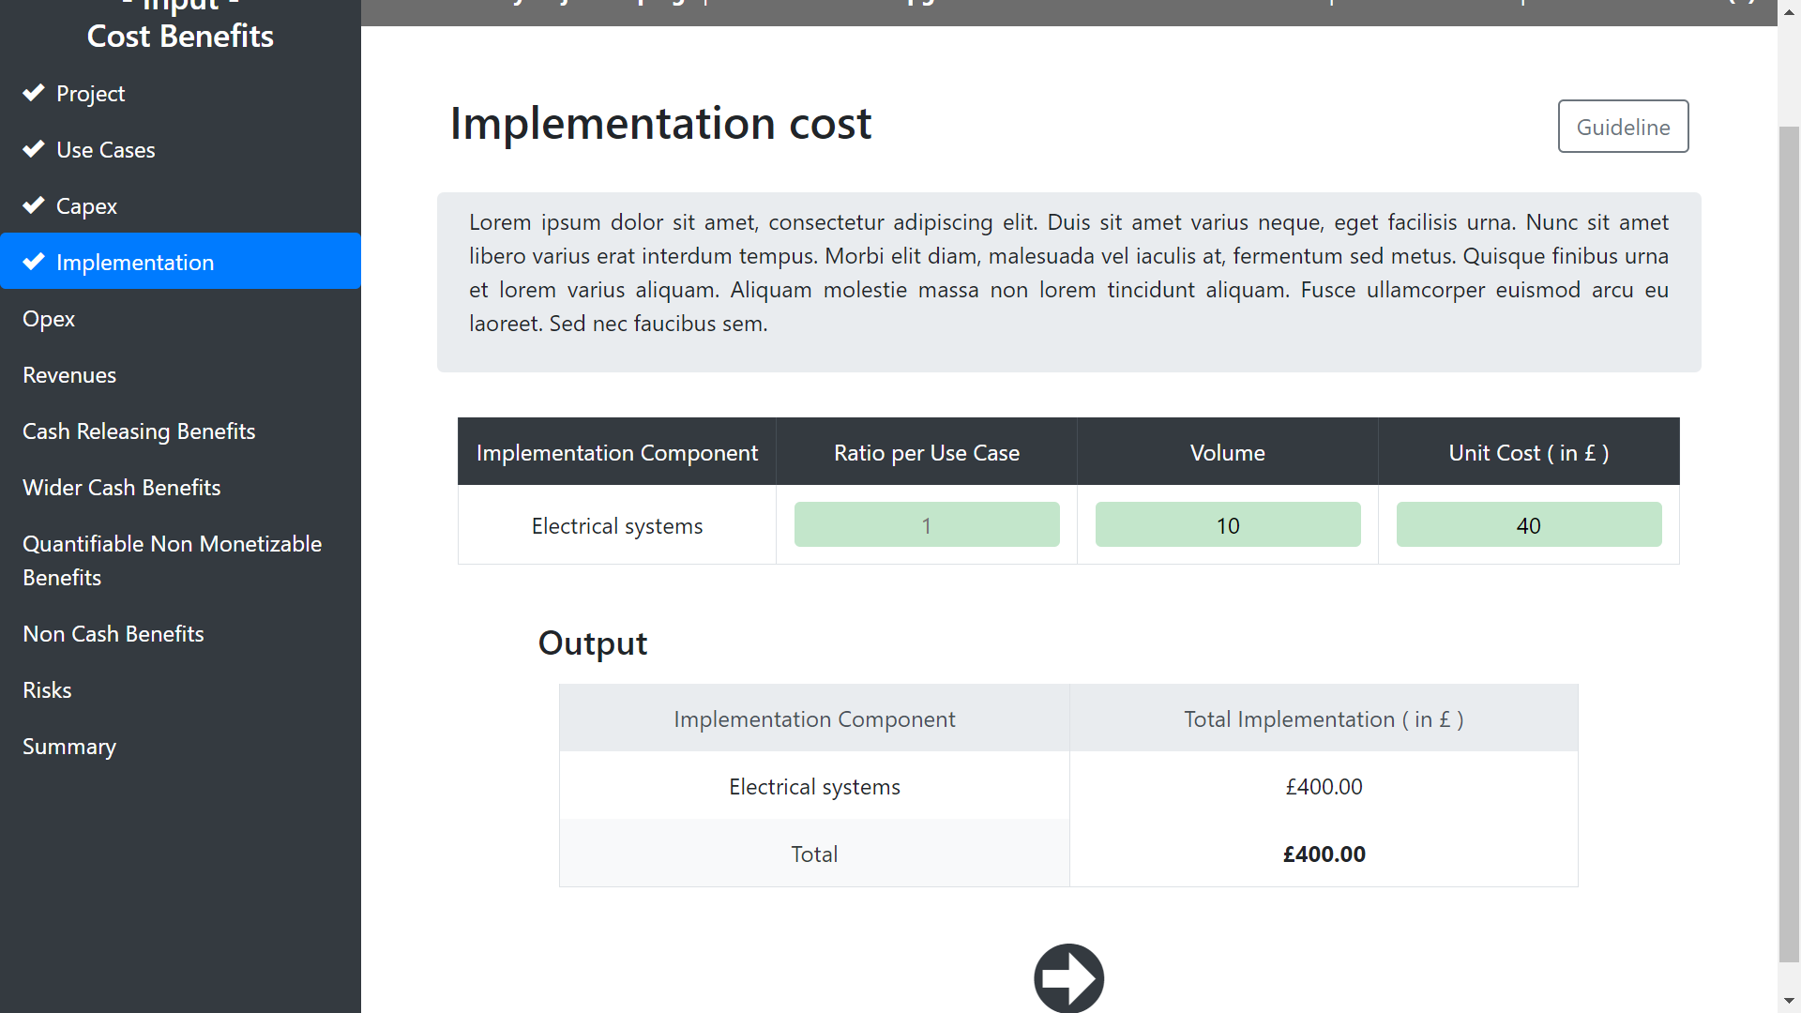
Don’t forget to look at
the guide line if you need help
Edit this table …
… and get the implementation cost

Slide 32
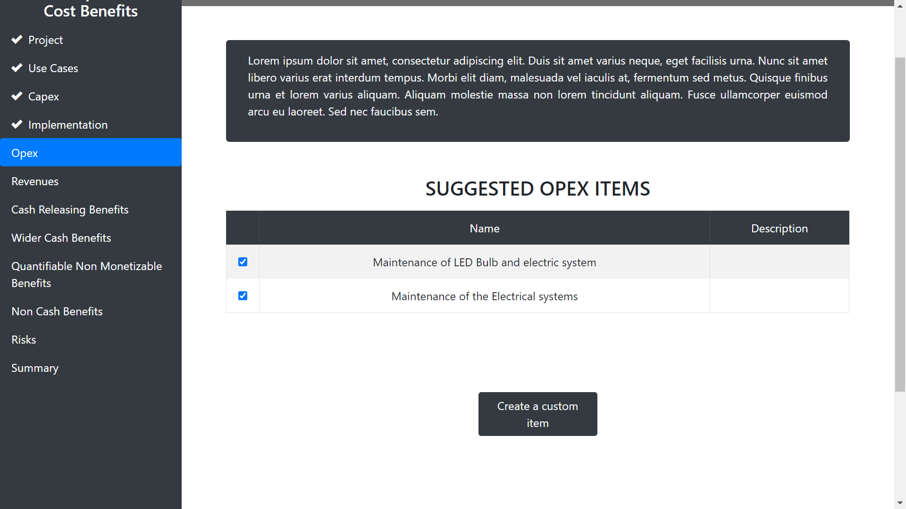
Select opex items from our data base
Create your own opex item

Slide 33
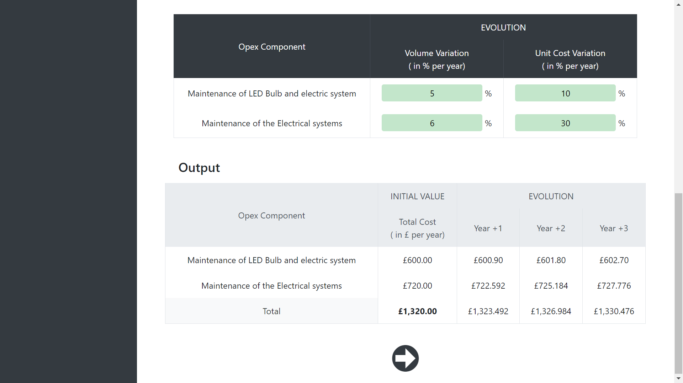
Edit this table …
… and get the opex cost
Opex

Slide 34
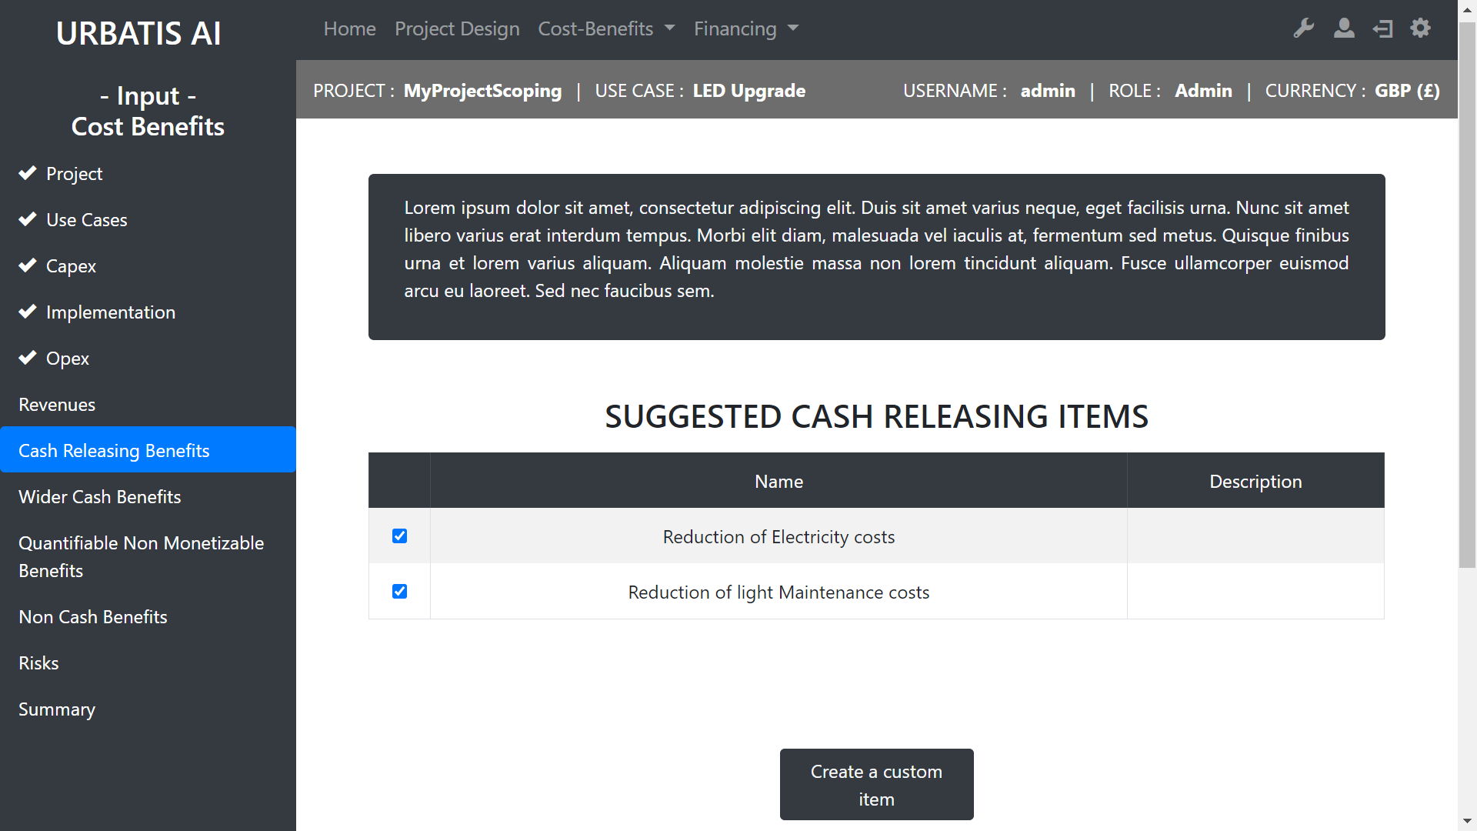
Select cash releasing items from our data base
Create your own cash releasing item

Slide 35
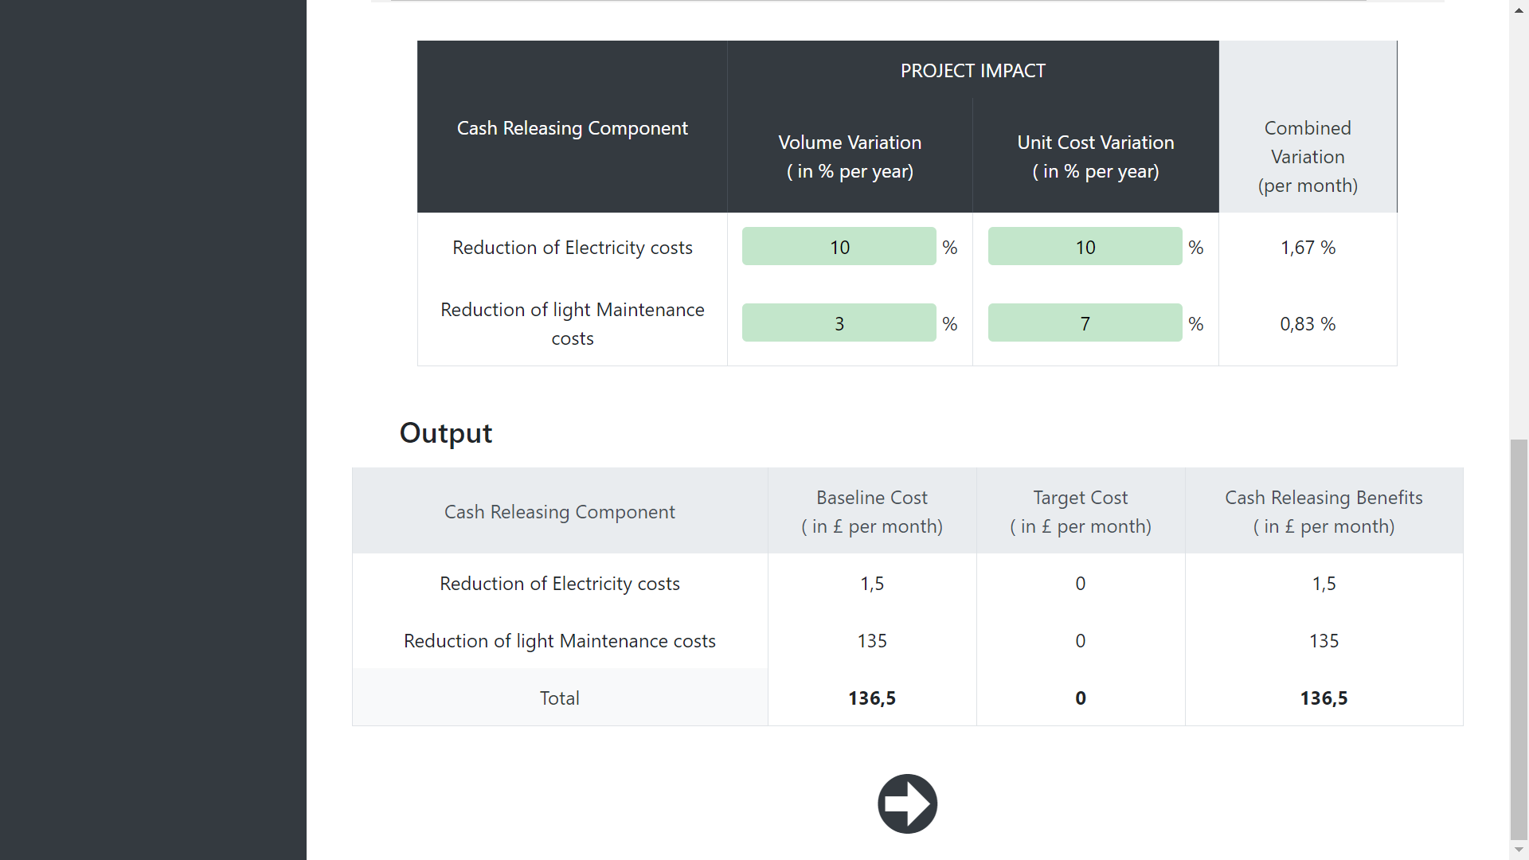
Edit this tables …
… and get the cash releasing summary

Slide 36
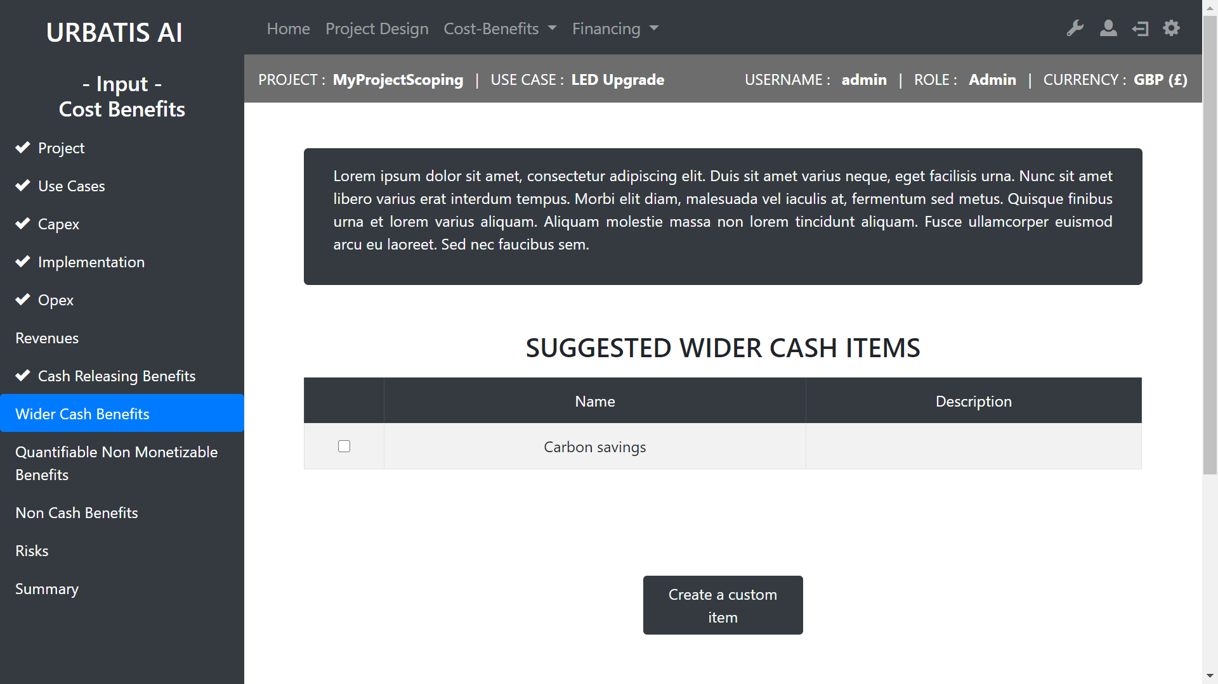
Select cash wider items from our data base
Create your own cash wider item

Slide 37
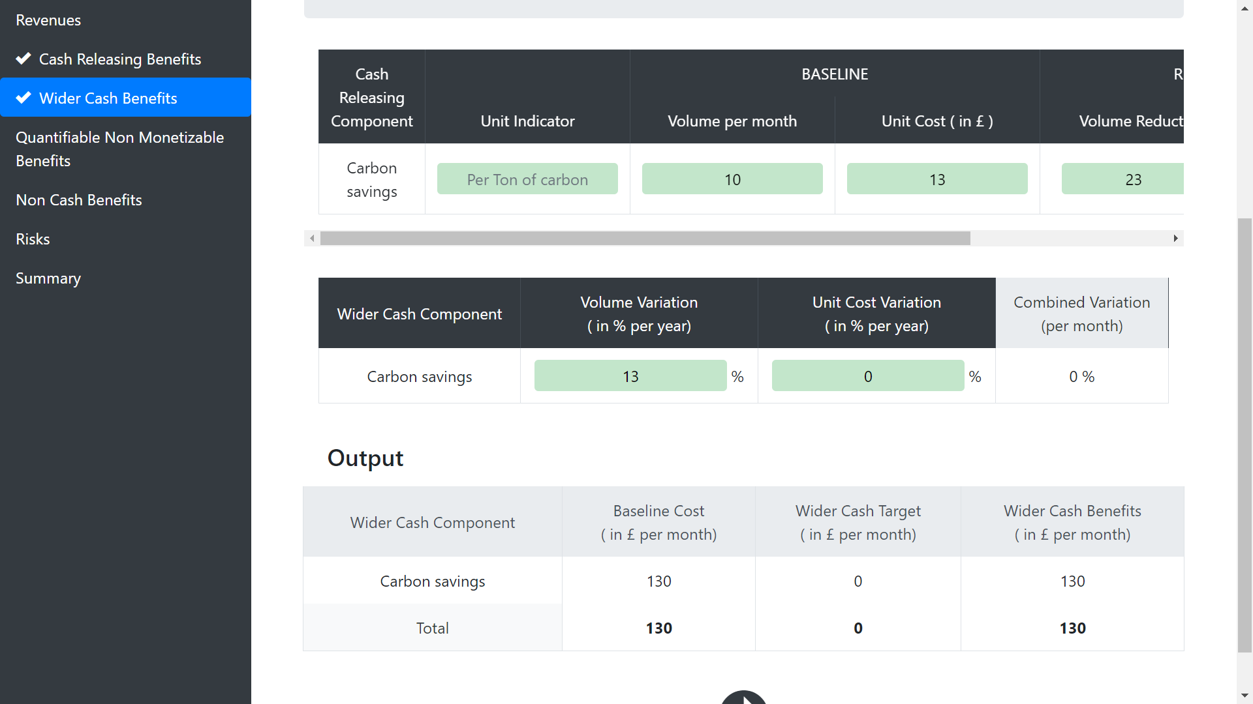
Edit this tables …
III Cost-Benefits
B - Cost Benefits
… and get the cash releasing summary

Slide 38
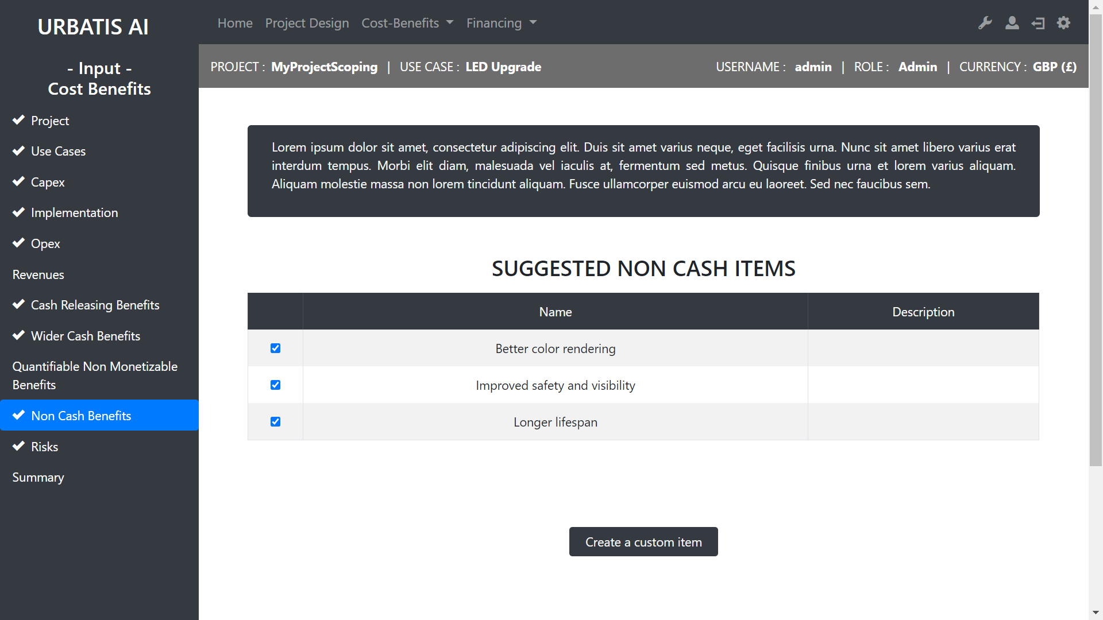
Select non cash items from our data base
Create your own non cash item

Slide 39
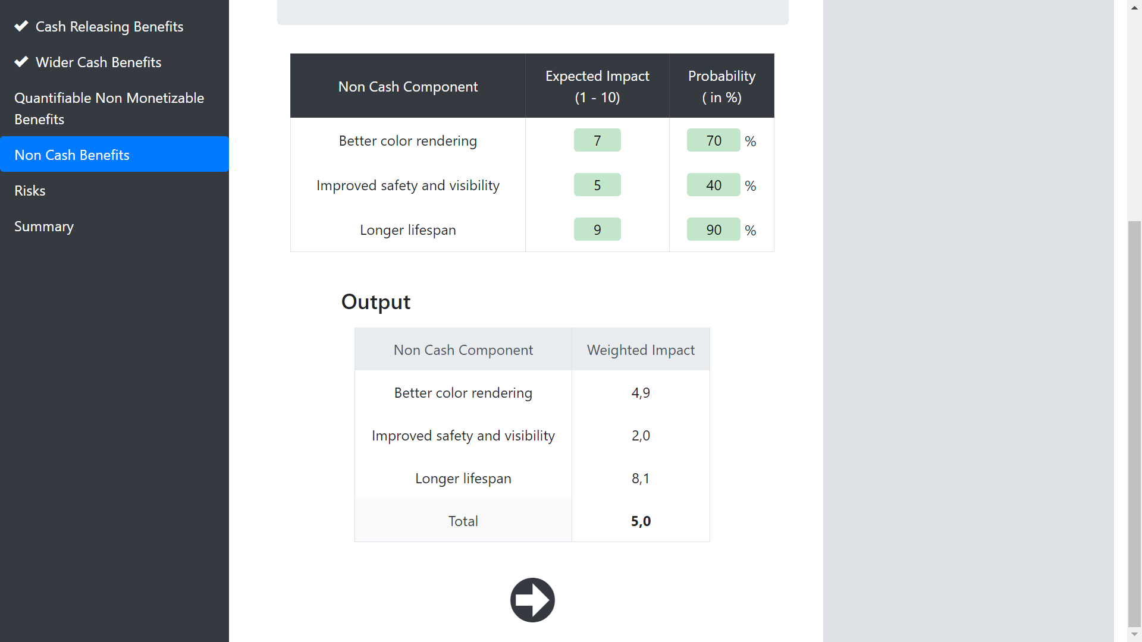
Edit this table …
… and get the non cash summary

Slide 40
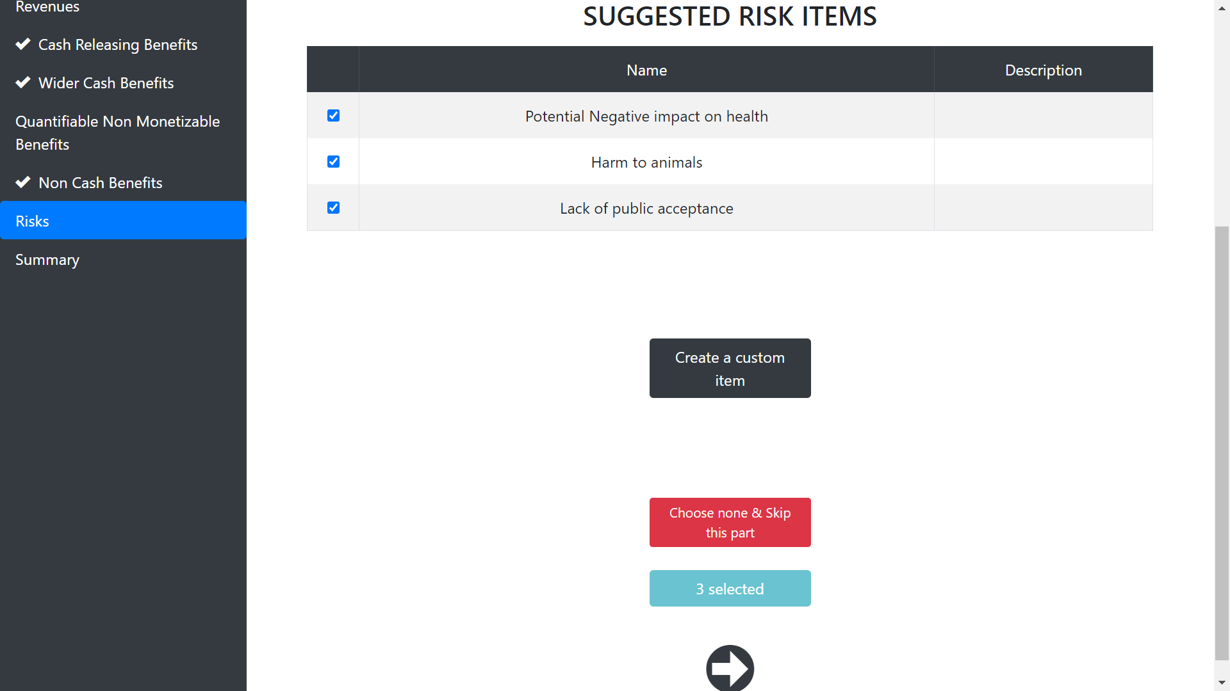
Select risk items from our data base
Create your own risk item

Slide 41
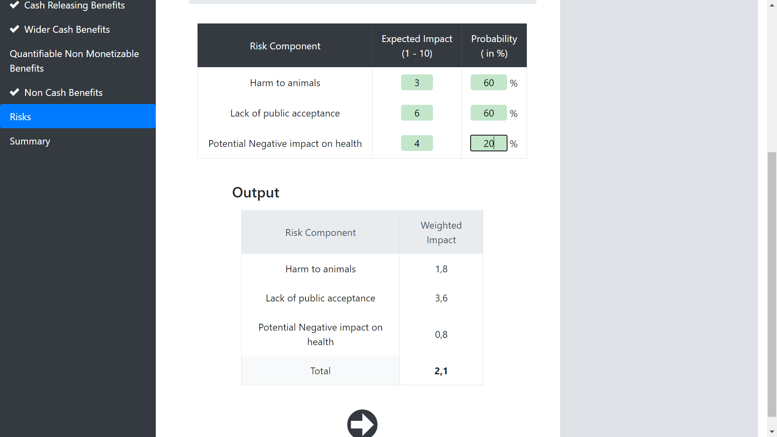
Edit this table …
… and get the risk summary

Slide 42
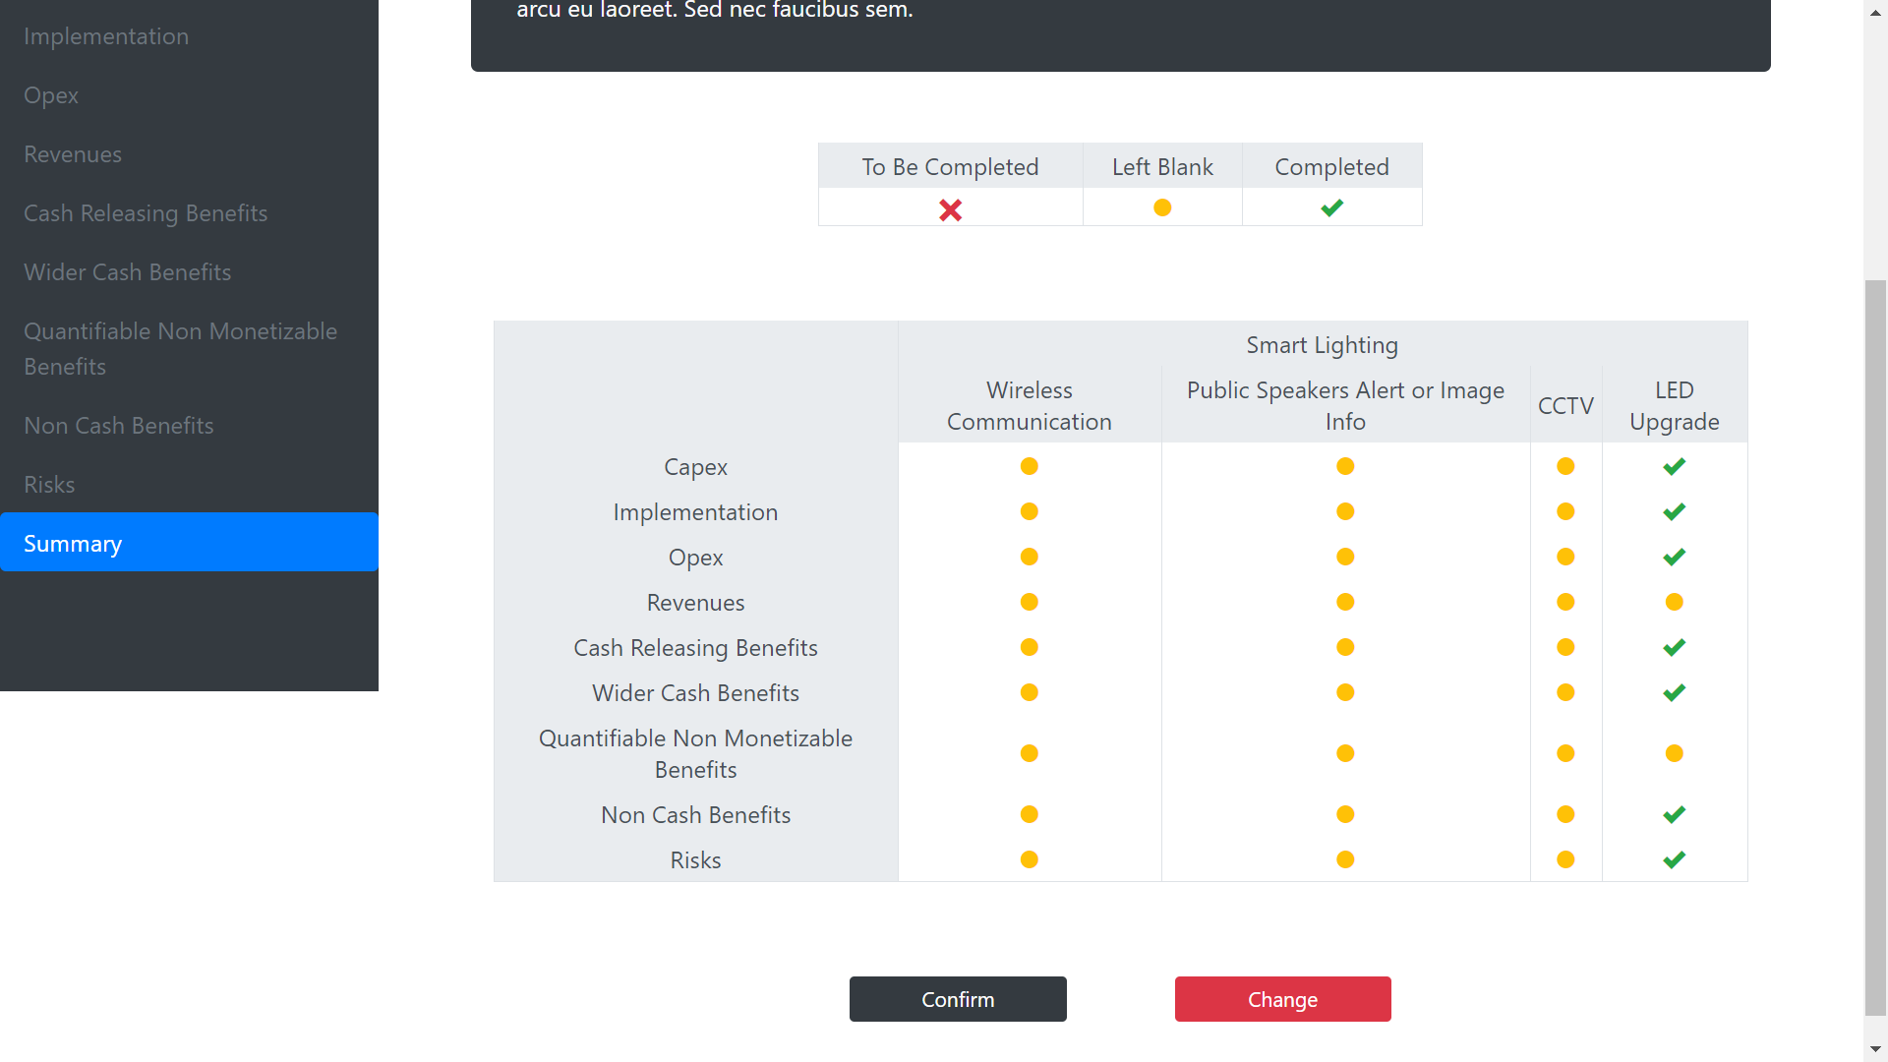
Finaly you have a summary of the information completed.

Slide 43
C - Dashboards
Back to summary

Slide 44
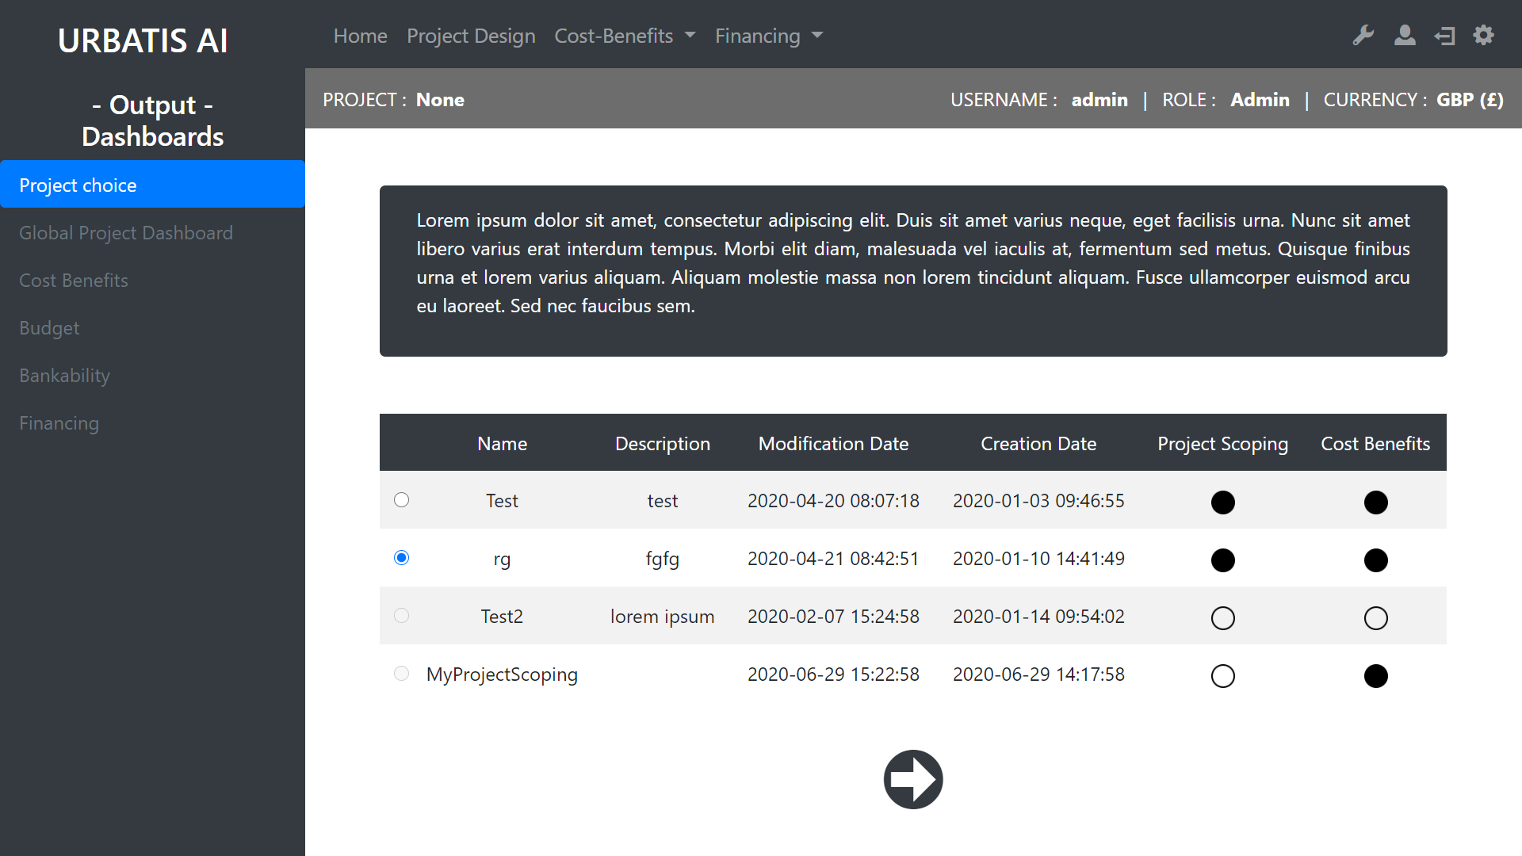
Select a project completed
Indicates wich part of the project is completed or not.

Slide 45
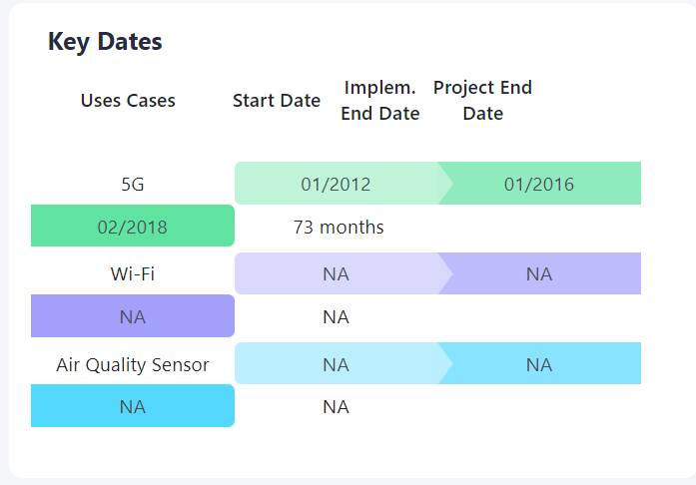
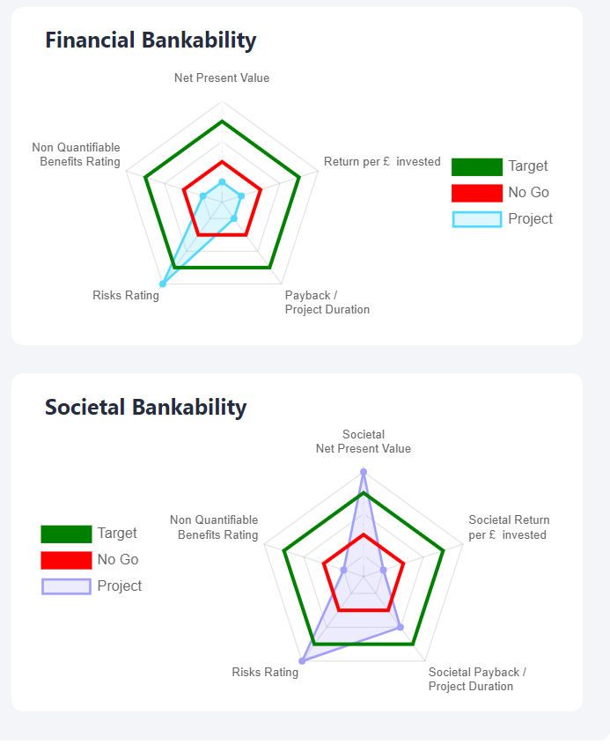
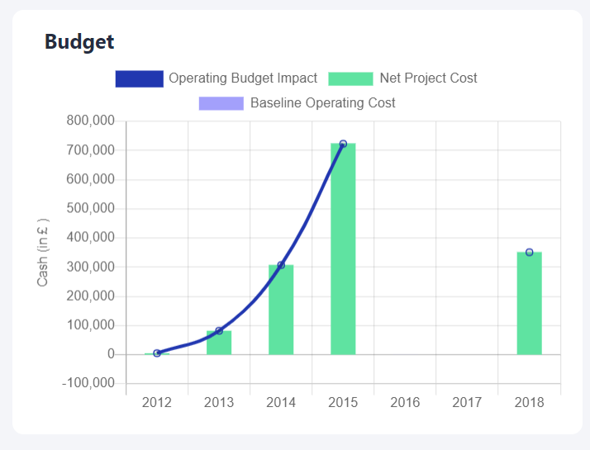
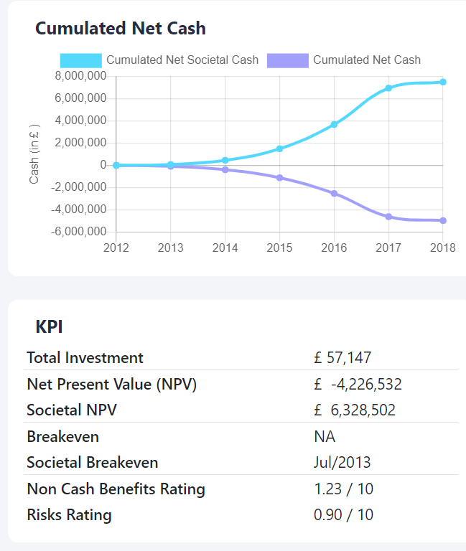
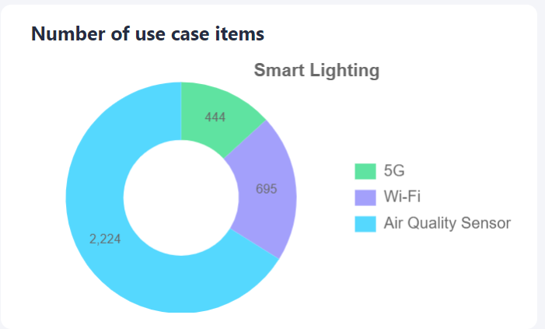
Global Project Dashboard : example of graph

Slide 46
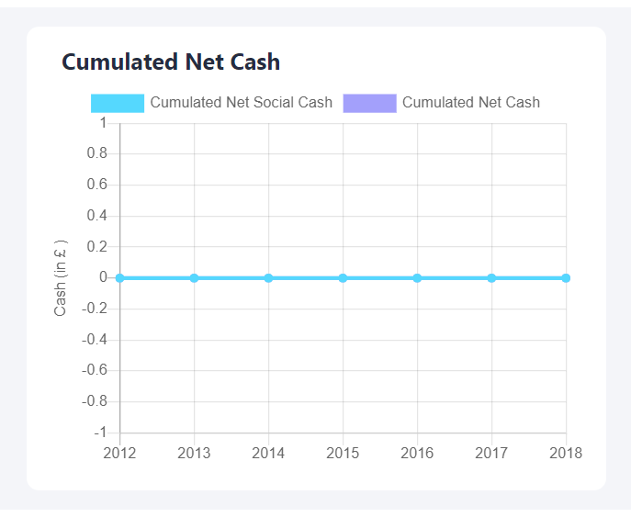
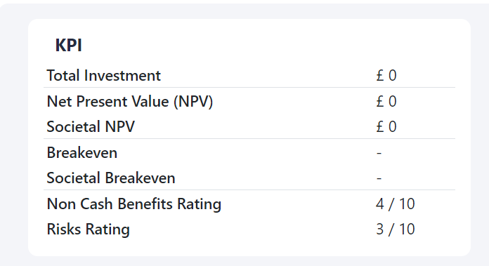
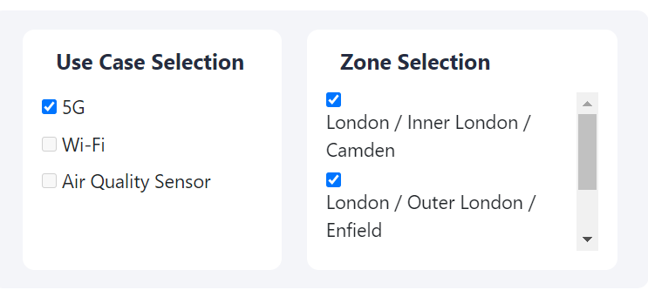
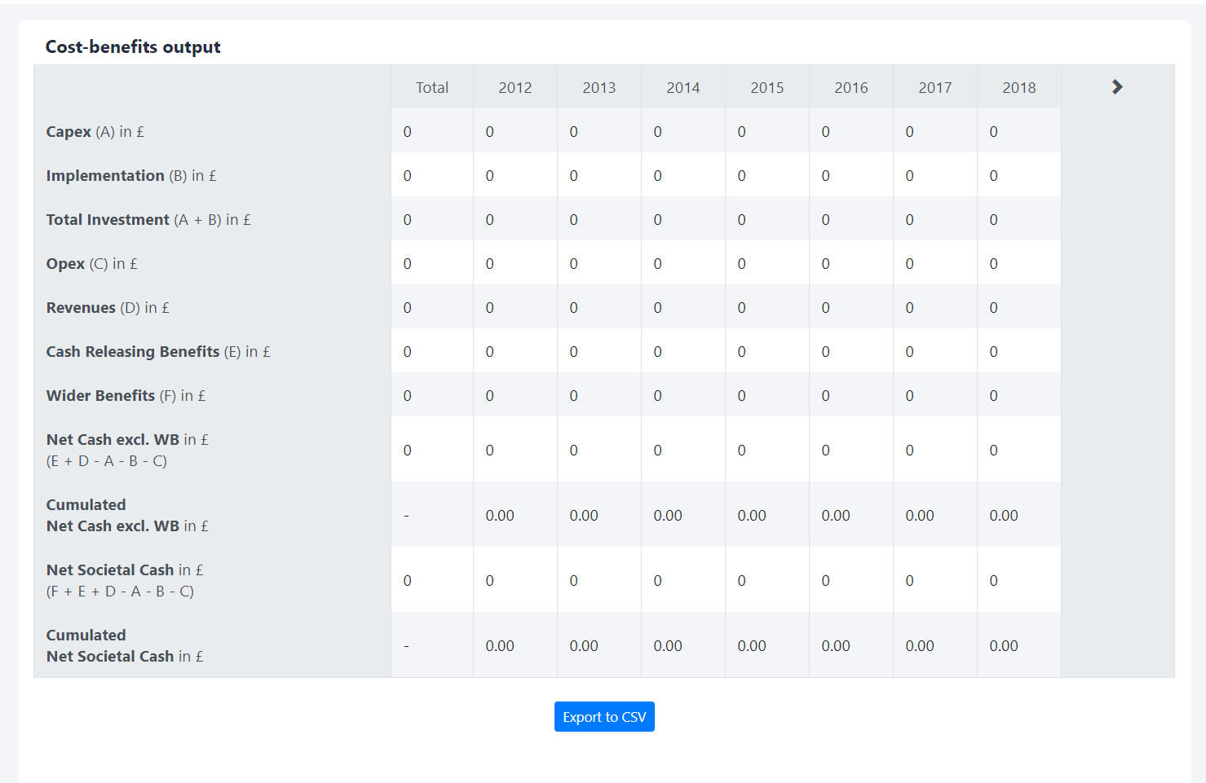
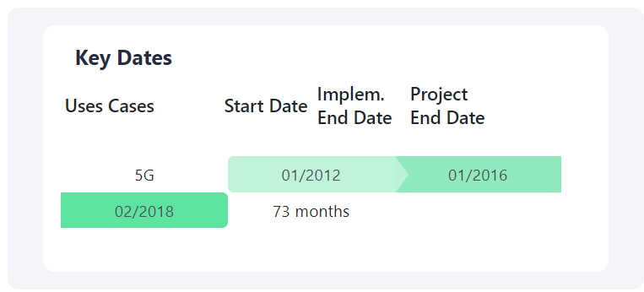
Cost Benefits Dashboard: example of graph

Slide 47
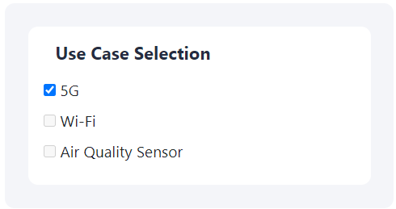
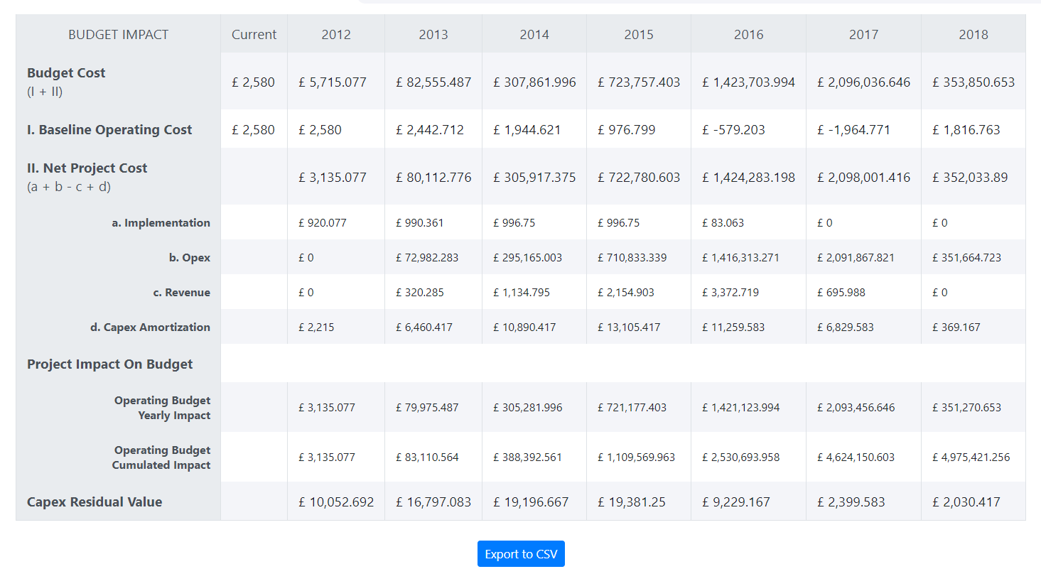
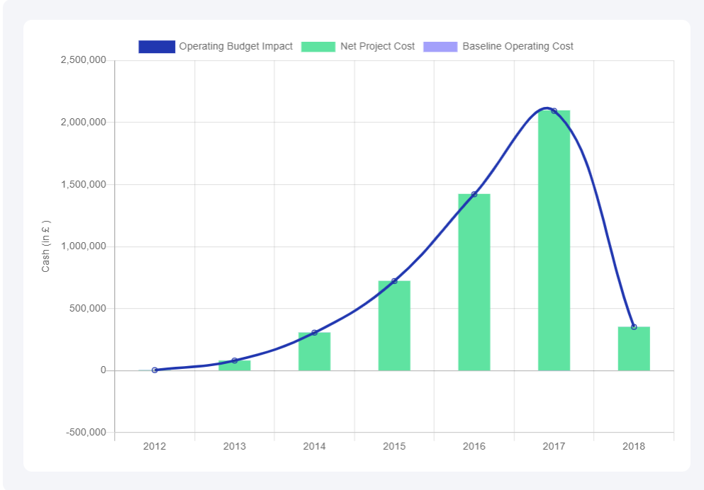
Budget: example of graph

Slide 48
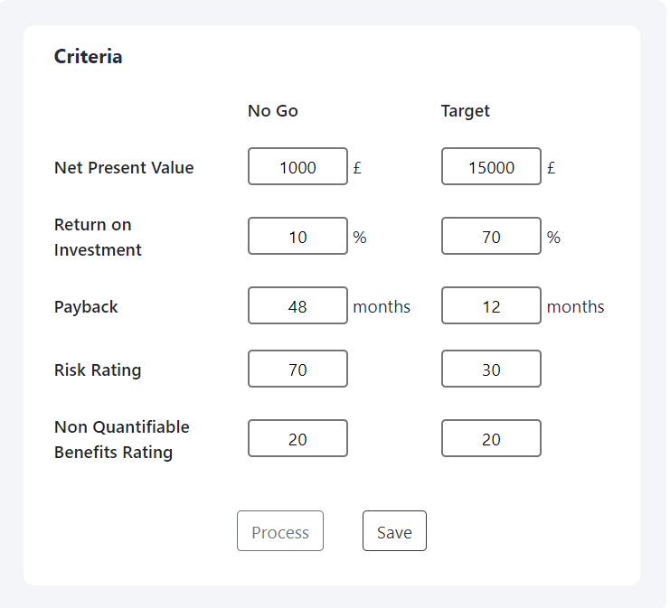



Bankability: example of graph

Slide 49

Select a Scenario

Slide 50





Financing: example of graph

Slide 51
D- Comparison
Back to summary

Slide 52


Slide 53


Slide 54


Slide 56


Slide 57


Slide 58


Slide 59


Slide 60


Slide 61


Slide 62


Slide 63


Slide 64


Slide 65
IV Financing
Back to summary

Slide 66
A - Funding
Back to summary

Slide 67


Slide 68


Slide 69


Slide 70


Slide 71


Slide 73


Slide 74


Slide 75


Slide 76


Slide 77


Slide 78


Slide 79


Slide 80
B - Business Model
Back to summary

Slide 81


Slide 82


Slide 83


Slide 84
V Settings
Back to summary

